Slide 1
50 to 1296 MHz Station Build
With Lessons Learned!
April 26, 2023
K1UU
Fred Caswell

Slide 2
Station Goals
Simple to operate. One button band changes.
Contest “low power category” power levels
50 & 144MHZ 200W
222 & 432 MHz 100W
902 & 1296 MHz 50W
Mast mounted LNA and filtering
Minimize feedline loss

Slide 3
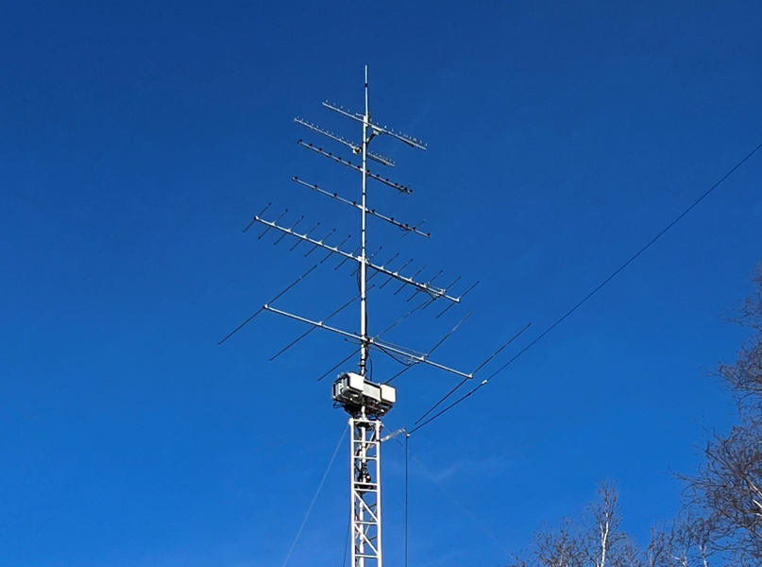
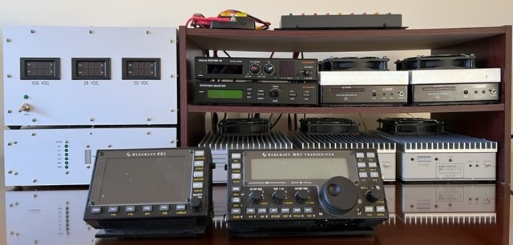
Finished Station
Shack: Power supply, “JBOX”, KX3 IF rig, (5) Q5 Signal transverters,
microHAM MKIII & station master.
Fuses and 10MHz GPSDO on top shelf.
Clearly, I need a new shelf.
50 foot tower with antennas, amplifiers and LNA’s
For 50 through 1296 MHz
Notes:
The 6 amplifiers as well as the “TBOX” are mounted on a frame made from 2” x 2” aluminum angle and 1” square tubing. The four large amplifiers are on the 4 corners. The two small amplifiers are in the front center. The “TBOX” is on the back center hidden from view.
The antennas: 50 MHz 5 elements, 144 MHz 14 elements, 222 MHz 9 elements, 432 MHz 14 elements, 902 MHz 19 element loop Yagi, 1296 MHz 25 element loop Yagi.
There is a small FM dual band vertical on top.

Slide 4
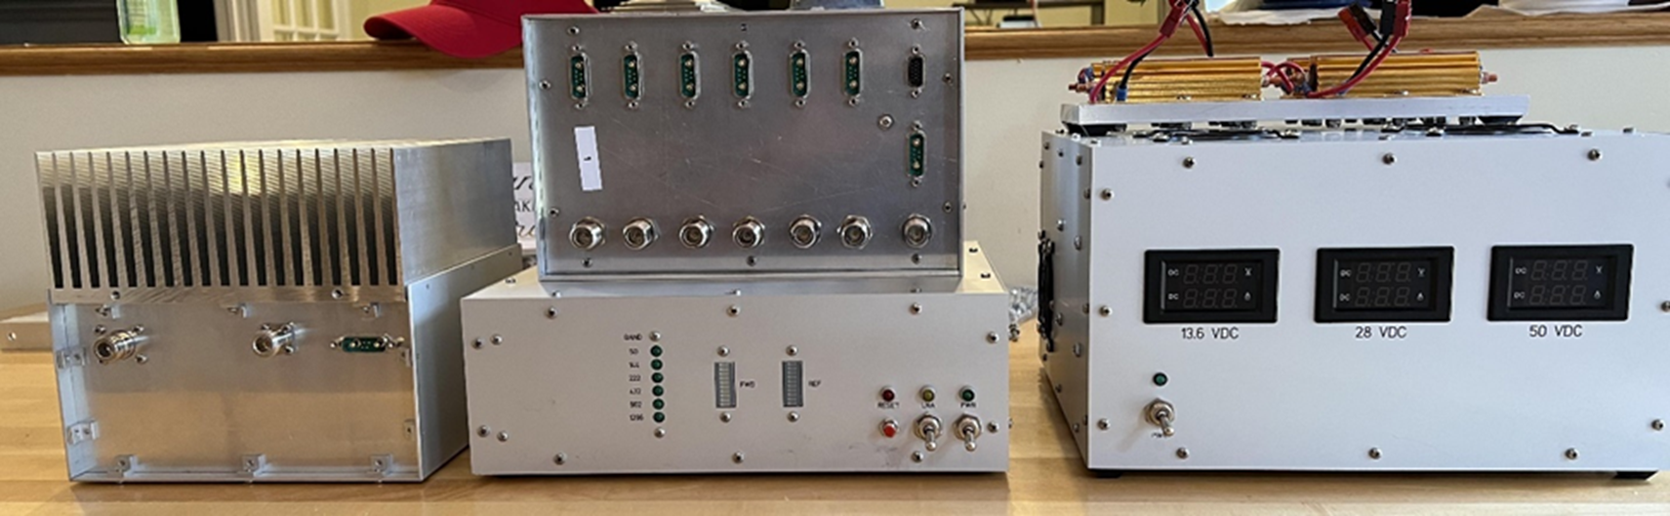
Boxes I Needed to Build
Amplifiers
50 MHZ 200W
144 MHz 200W
222 MHz 100W
432 MHz 100W
Distribution Boxes
Outdoor (TBOX)
Indoor (JBOX)
Power Supply
13.6V
28V
50V
Notes:
When I started, I had the 5 transverters, the microHAM MKIII and station master, the GPSDO & distribution.
I used Front Panel Express for all the sheet metal. I used Heatsink USA for the heatsinks and the heatsink machining.

Slide 5
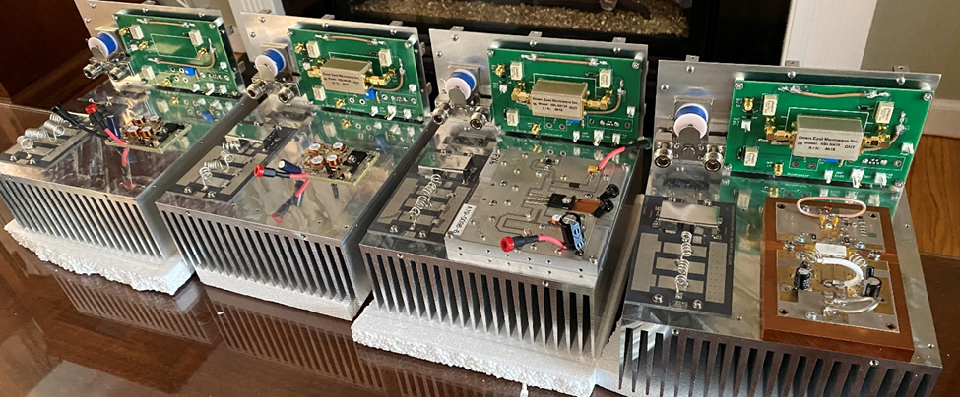
Amplifier Key Components
Notes:
Photo is before wiring and shielding installation. From left to right: 50MHZ, 144 MHZ, 222 MHZ, 432 MHz. On the back panel of each amplifier is a board holding the T/R switching and the DEMI LNA. On the front left on each heatsink is the W6PQL LPF / couplers board. On the front right on each heatsink is the RF amplifier pallets/boards. The 432 amplifier on the right uses a W6PQL 500W RF pallet. Note the small 2” x 3” RF boards on the 50MHz and 144 MHz amplifiers.
I used ExpressPCB for circuit boards.

Slide 6
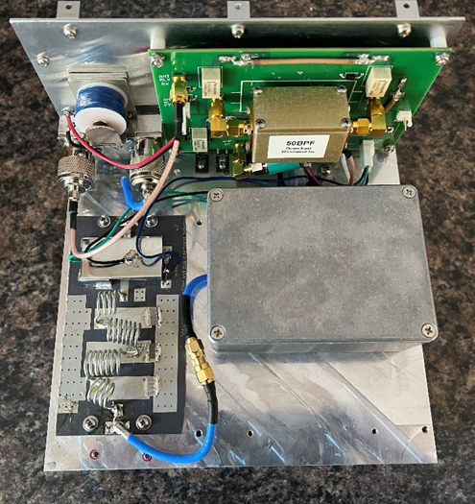
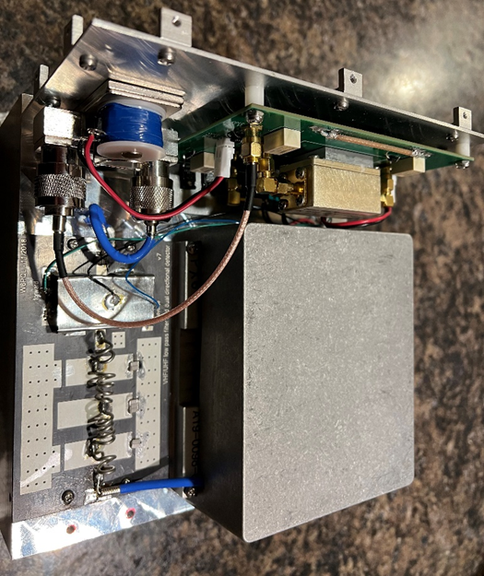
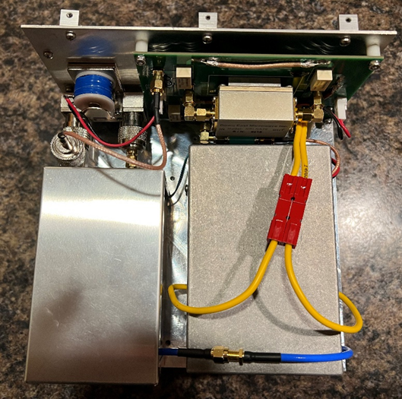
Amplifiers – Wired & Shielded
50 MHz (same as 144 MHz)
222 MHz
432 MHz

Slide 7
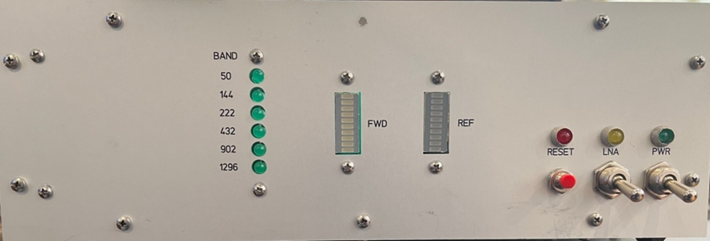
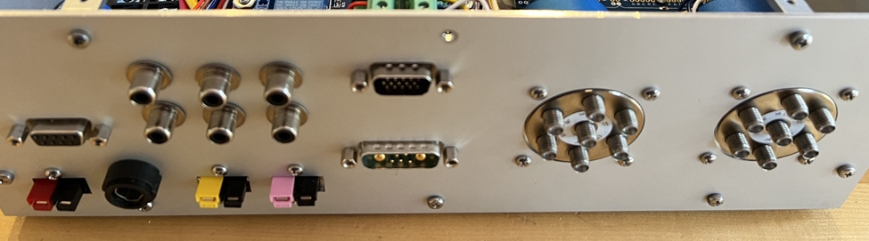
JBOX – Front and Rear Panel
Notes:
Front panel from left: band indicator LEDs, FWD power LED bargraph, REF power LED bargragh, latch reset button and LED, LNA on/off switch and LED, power on/off switch and LED. In the box there is a simple 2 transistor flip-flop. It flips if the SWR exceeds 3:1 thereby cutting off the amplifier PTT and the transverter PTT.
Rear panel from left on top: DB9 for band data from the station master, 6 phono jacks for PTT to transverters, DB9 size (15 pin) band data to TBOX on tower, two SP6T Teledyne relays to select transverter input and output.
Rear panel from left on bottom: 13.8V power pole connector (PP), fuse holder, 28V PP, 50V PP, DB9 size connector with two power pins and 5 signal pins to provide DC power and LNA, PTT, FWD, REF signals to/from the mast mounted amplifiers.

Slide 8
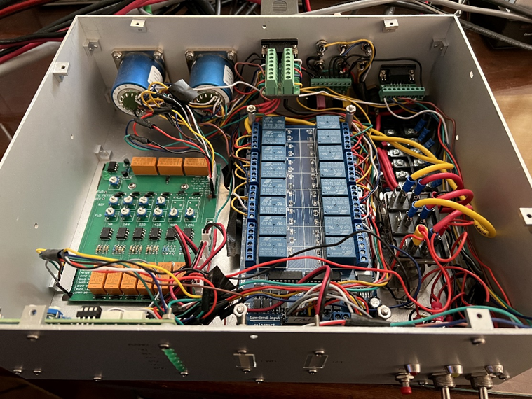
JBOX - Interior
Notes:
On the left is the SWR display management board with Op Amps and pots for calibration. The SWR comparator and flip-flop are in the top left corner. On the right is two (one under the other) blue relay boards The boards cost $15 each on Amazon. I chose the cheap boards, but the downside was all the point-to-point wiring.

Slide 9
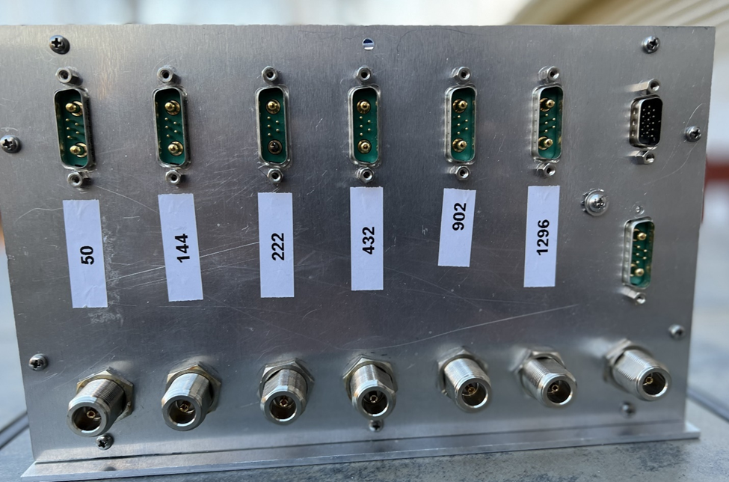
TBOX – Bottom Panel
Notes:
On the far right, top down: band data connector, DC power and signal connector, RF input connector. There is a DC power signal connector and an RF connector for each band.

Slide 10
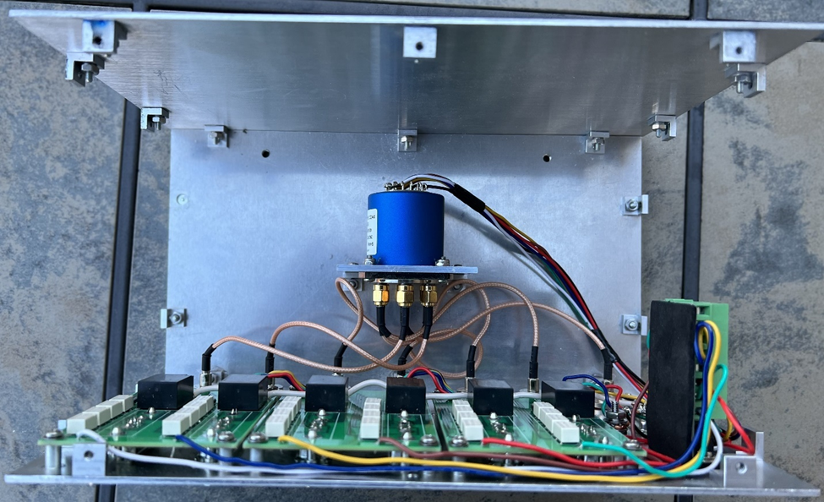
TBOX - Interior
Notes:
Teledyne SP6T for RF. My design PCBs with relays to switch DC power and PTT, LNA, FWD, REF signals.

Slide 11
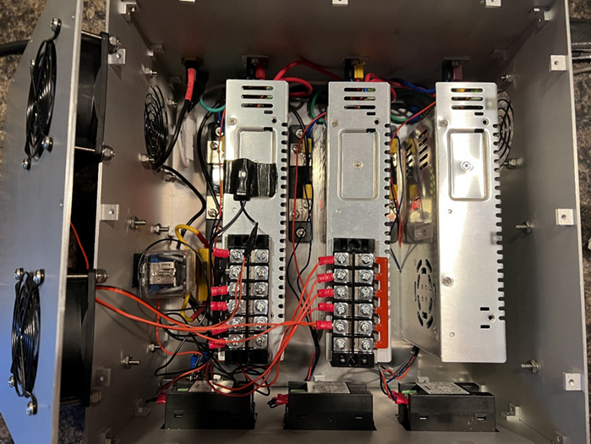
Power Supply - Interior
Notes:
Power supply is a simplified version of the design on the W6PQL website. It uses (3) “DROK” 0-24V, 20A units in series. Each unit costs $39 on Amazon. The unit includes inrush current protection and a thermal sensor to turn on the cooling fans if the temperature rises above 100F. The top cover with fans is leaning on the left side of the box.

Slide 12
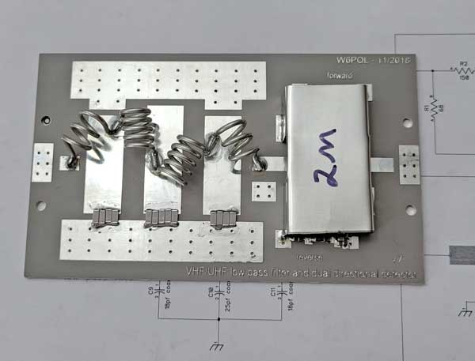
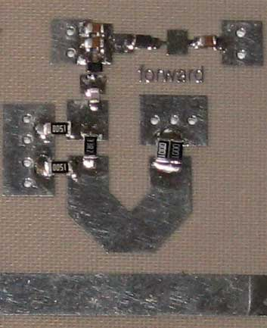
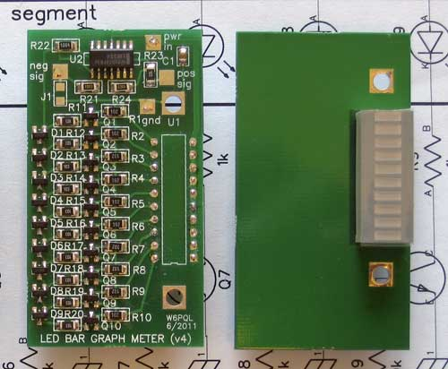
Lesson #1 – Read the Data Sheet!
W6PQL Couplers and Bar Graphs
W6PQL LED bar graph
Attenuator
View of forward power coupler
under the shield
W6PQL shows the attenuation for each coupler on the website data page. He uses attenuation to match the coupler to the LED bar graph voltage level.
W6PQL low pass filter and dual coupler board

Slide 13
Lesson #1 – Read The Data Sheet!
W6PQL Couplers and Bar Graphs
Issue: I incorrectly designed and built a board to calibrate and display SWR
forward and reflected power from the mast mounted amplifiers.
I assumed:
Couplers provide positive voltage
2-5V range
Voltage increases with RF power
Data Sheet reality:
Couplers provide negative voltage
30mV to 300mV range
Voltage decreases with power
Corrective actions
Designed and built new board to manage SWR
New board uses inverting Op Amp circuits

Slide 14
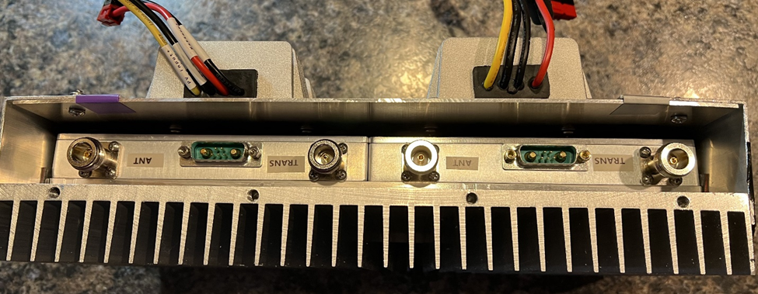



1296 & 902 Amplifiers
DC to DC converters
50V to 14V
Pin A1
Pin A2
902 and 1296 MHz 50W amplifiers mounted on a large heat sink and covered for weather protection

Slide 15
Lesson #2 – Don’t Trust the Data Sheet!
902 and 1296 Amplifiers
Issue: I burnt out my 902 and 1296 MHz amplifiers because I provided 13.8V
to the wrong connector pin.
902 Data Sheet
Page 1: Pin A2 = red wire = +13.8V
Page 3: Pin A2 = red wire = +13.8V
1296 Data Sheet
Page 1: Pin A2 = red wire = +13.8V
Page 3: Pin A1 = red wire = +13.8V
Actual Hardware
902 Amp: Pin A1 = red wire = 13.8V
1296 Amp: Pin A1 = red wire = 13.8V
Corrective actions
Had both amps repaired. Thankfully, it was just a few capacitors and a regulator.
Changed wiring of cables connecting 13.8V to the 902 and 1296 amplifiers

Slide 16
Lesson #3 – Read The Data Sheet!
902 and 1296 Amplifiers
Issue: The 902 and 1296 MHz amplifiers produced zero output in my initial station
design.
Assumptions
50W, 50% efficient = 100W
100W / 12.5V = 8A needed
10A relays are adequate
14-gauge wire is adequate
Data Sheet reality
20A needed!
100 ft 14-gauge = 1/4 ohm
20A x 0.25 ohm = 5V drop!
Corrective actions
Replaced 14-gauge wire with 10-gauge
Sent 50V up the tower instead of 13.6V
Added 50V to 14V converters for each amplifier

Slide 17
Lesson#4 – Sometimes it IS the Test Equipment
Test setup was the fully integrated station. Included all boxes, all interconnect cables and the full lengths of the actual coax and the actual power and signal wires
Test goals:
  Harmonics – need to be 60dB below the carrier at full power
  Two-tone IMD – 3rd order peak needs to be 30 dB below the carrier at full power
  Spurious emissions – need to be 60 dB below the carrier at full power

Slide 18
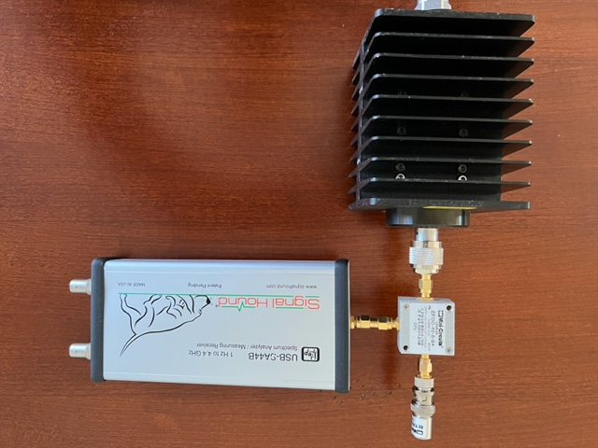
Lesson#4 – Sometimes it IS the Test Equipment
Minicircuits 50-ohm load
Signal Hound 4.4 GHz
spectrum analyzer
USB SA-44B
Minicircuits 2GHz, 10 dB
coupler
Minicircuits 40 dB, 100W
4 GHz attenuator

Slide 19
Lesson#4 – Sometimes it IS the Test Equipment
Issue: 2nd harmonic on 50MHz amplifier only 53 dB below carrier.
Actions taken and results (over a 6 week period):
Measured the harmonics with no low pass filter in line – same result
I thought the MRF300 quiescence current might be set for class C operation and tried 15 current levels between 50 mA and 1 amp…no change
Maybe the filter required shielding – no change
Maybe the amplifier board required shielding – helped some
I put the cover on the unit and the harmonic got worse
I cut a 100 MHz stub that had 27 dB dip – no joy
I built a 50MHz / 100MHz diplexer - nothing
W6PQL uses a “standoff” length of coax on his 50MHz amplifier between the amplifier and the filter – lots of connector soldering, no results
Changed the coupler in the test setup – problem solved!!!

