Slide 1
EVIL TELEVISION RFI
How to Co exist with those 1 Megawatt TV behemoths
Dave Olean K1WHS

Slide 2
Chronological History of TV Channels
Original channels 2-13 and 14-83
Analog TV occupied 54-88 MHz, 174-216 MHz, & 470-890 MHz
1983 UHF Ch 70-83 removed for land mobile use
2009 Ch 52 -69 removed for cellular phones
2019 38-50 removed for more cell phones
Today only UHF Ch 14-36 are in use for TV broadcasting. Ch 37 reserved for radio astronomy

Slide 3
UHF TV FREQUENCIES
Channel 14: 470-476 MHz
Channel 36: 602-608 MHz
Channel 13: 210-216 MHz
Channel 12: 204-210 MHz
Channel 11: 198-204 MHz
For a listing of channels in your area, check out:
https://otadtv.com/tvtower/index.html
https://www.rabbitears.info

Slide 4
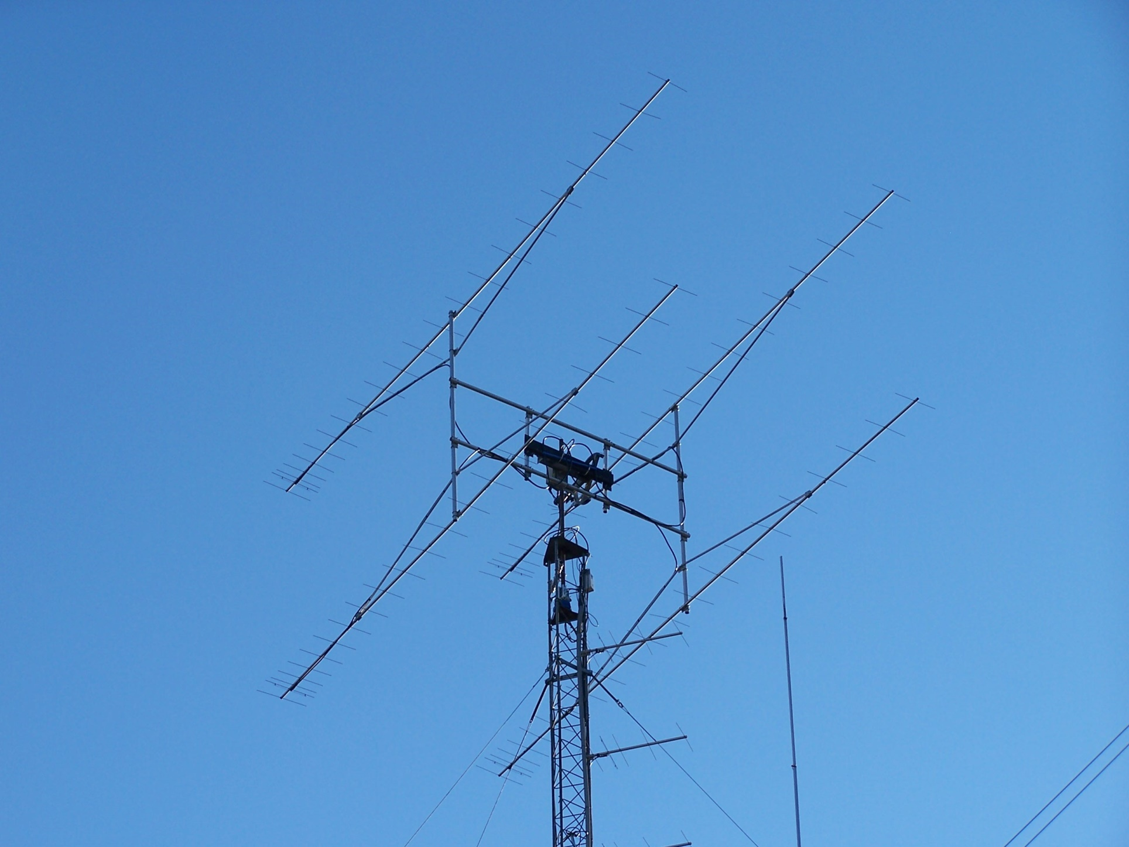
A SHORT HISTORY OF MY RFI
( Cue the violins! )

Slide 5
Fundamental Overload Situation
Strong TV station located within the passband of your preamp and transverter system
TV overload sounds like random noise.
What does your preamp front end look like?
Preamp should have gain set as low as possible. Otherwise, you overload subsequent stages in the transverter Filters? Attenuators?
Use a preamp with good dynamic range. That means it draws more current typically.

Slide 6
A First Attempt at Tower Mounting
Use a SOTA preamp
Put it in a weather proof box with some RF switching
Get ready for DX. Yeah…Right!

Slide 7
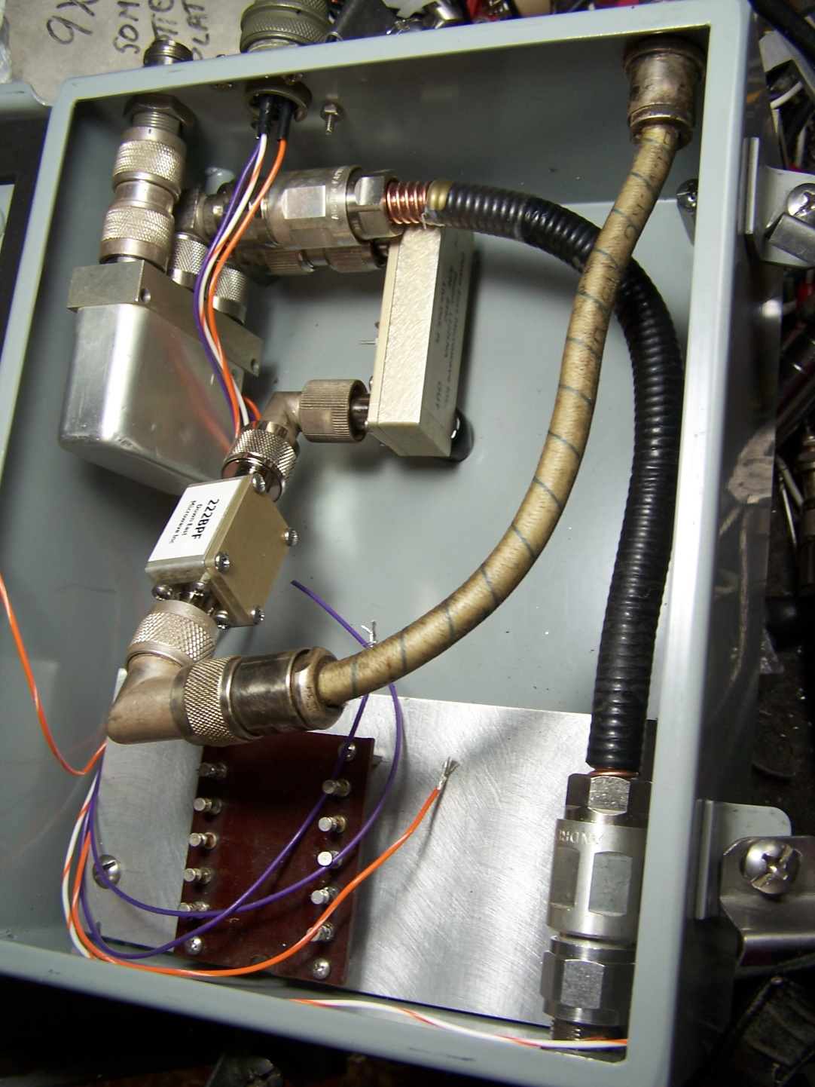
Original Tower Mtd Preamp with RELCOM Coax relay & DEMI preamp

Slide 8
The Results
Close, but no cigar!
Tower Mtd Preamp #1 did not cut the mustard
Channel 11 at -28 dBm with noise peaks at about -18 dBm introduced a few dB of excess noise at 222 MHz when aimed at the TV site.
The preamp was fine everywhere else
Unfortunately the TV station was at 219 degrees, the same heading as NYC area.
How to eliminate the few dB of RFI.

Slide 9
If do not contemplate EME
A tower mounted preamp is a great idea on 222 MHz and higher. (Sky noise is low)
Use a good low loss filter in front of it.
I saw about a 2 dB S/N improvement with the tower mounted preamp. VERY NOTICEABLE.
A filter after the preamp will save your transverter from unwanted overload, mixing, or 3rd order intermod problems.

Slide 10
Attempt #2
“We’re gonna need a bigger box”
WD5AGO Silver Plated Cavity Preamp is BIG.
Update the coax relay to a QRO design
Input circuit has much better selectivity below the operating frequency. Channel 11 is at 204 MHz. Input cavity has loss at 204 MHz.
Better coax relay Dynatech with SC conn’s.
The good cavity preamp removed all RFI.

Slide 11
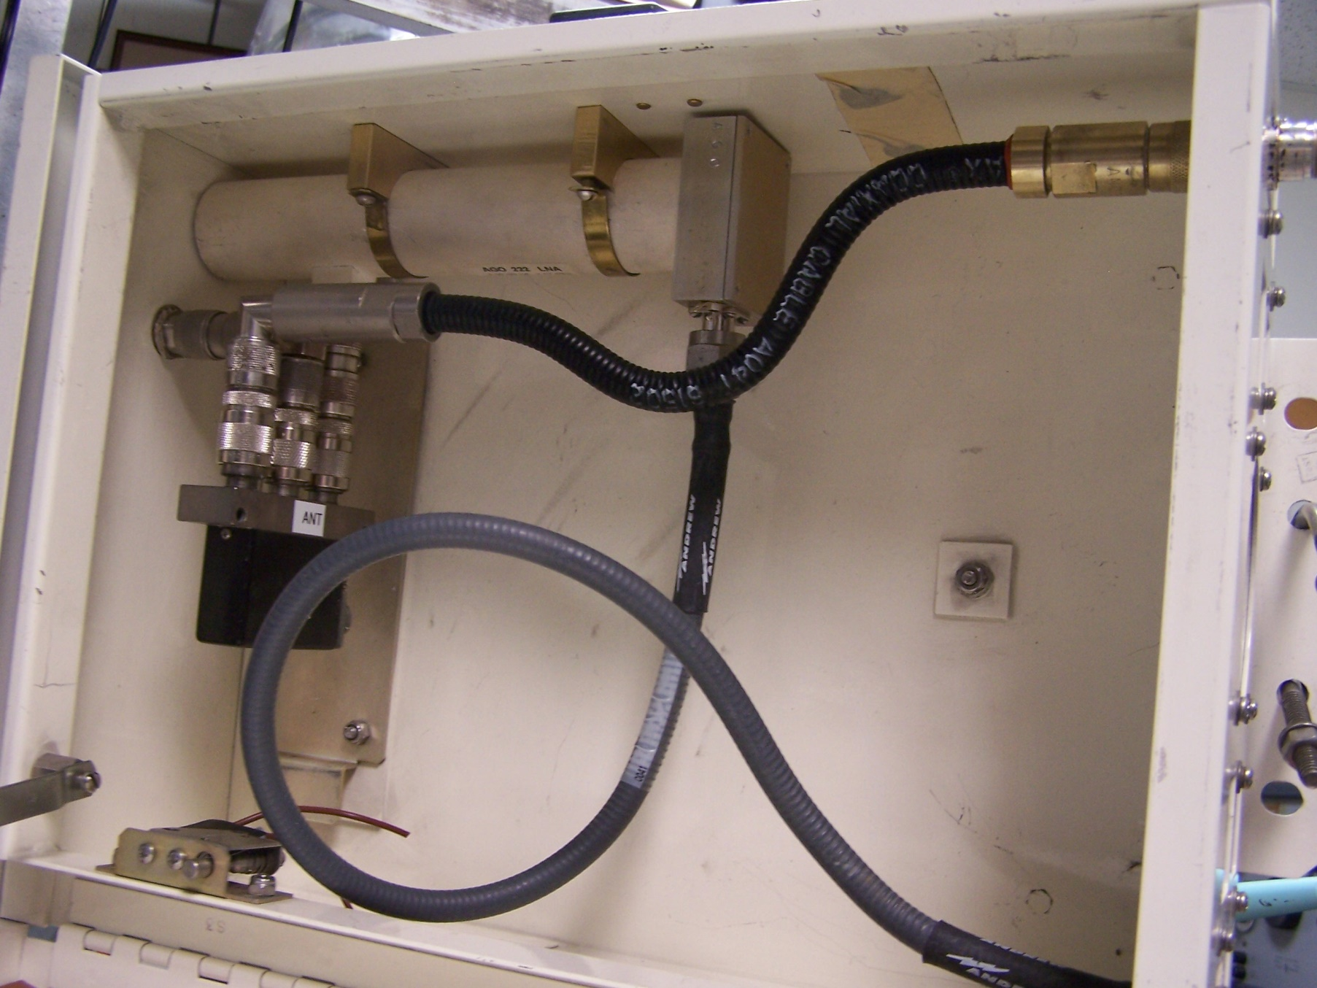
Version 2.0 Larger Preamp housing for WD5AGO preamp and high power coax relay.
Preamp coax input is right next to the Dynatech Hi power coax relay.

Slide 12
AGO CAVITY PREAMP
The cavity preamp is built with special TX FET
Input circuit is very lightly loaded by the FET.
After many attempts, it was the only solution on 222 MHz for EME.
222MHz= 17.5 dB gain. P1dB Input = -5 dBm (+11.5 dBm out)
207 MHz= 0 dB gain
Slight loss at CH 11. -5 dB estimated.

Slide 13
Some Typical Preamps
Homebrew style GASFET Fujitsu MGF?
LNA Technology Cavity Preamp High End
DEMI 222LNA with SAW Filter. (available on other bands as well)
Untuned MMIC stages cause trouble if exposed to the outside world! Beware!!

Slide 14
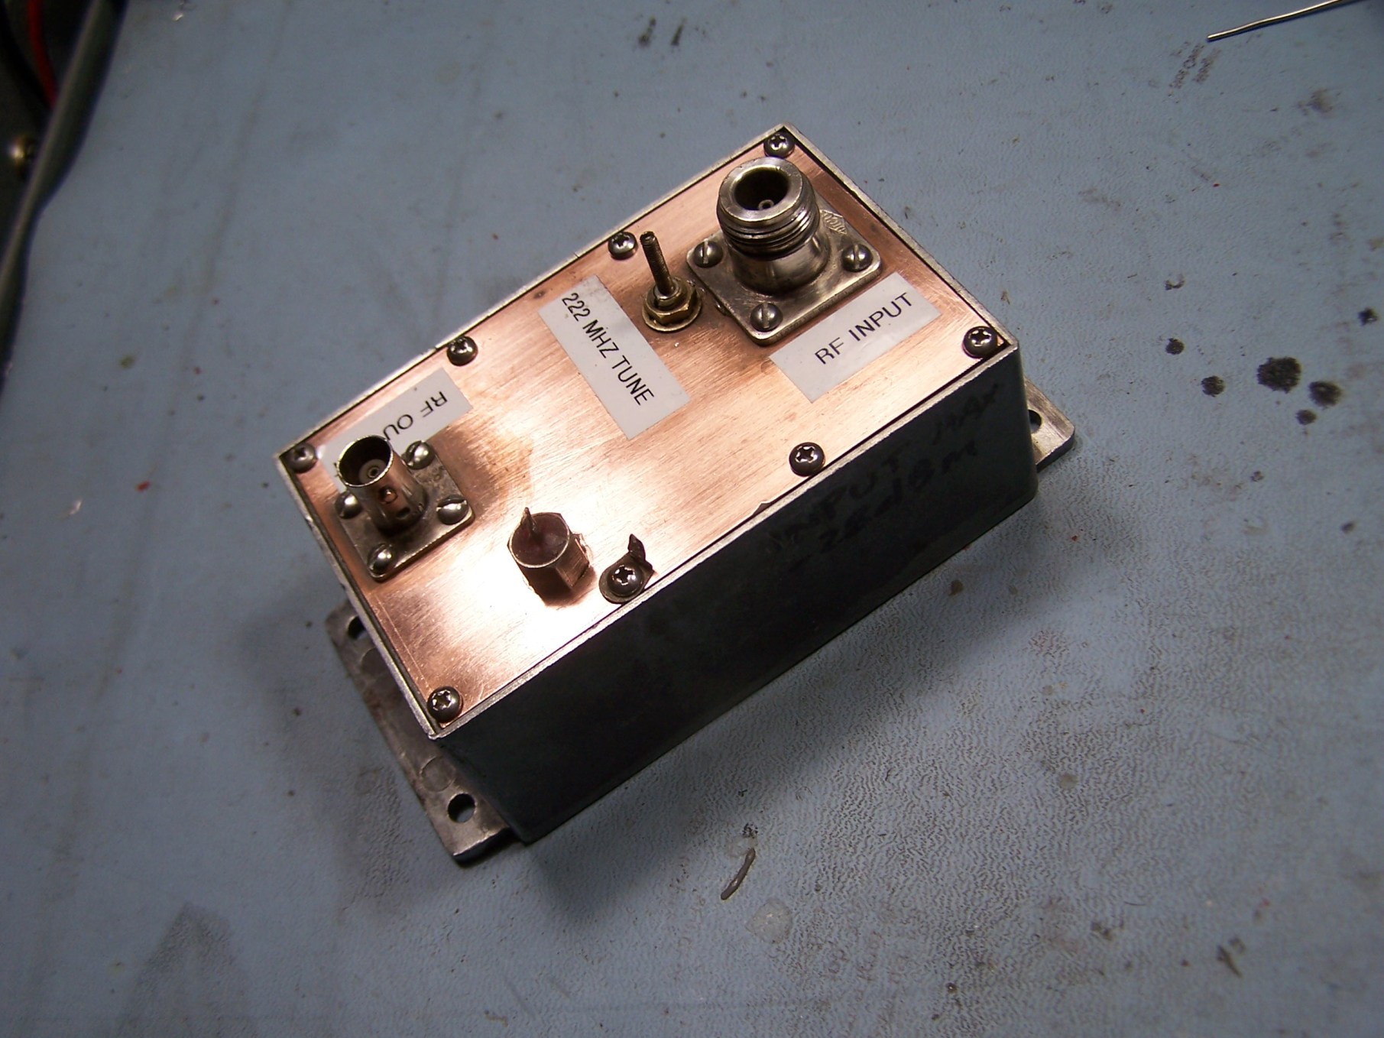
Homebrew GaAsFET preamp design with silver plated input coil and piston trimmer input
P1dB = -28 dBm

Slide 15
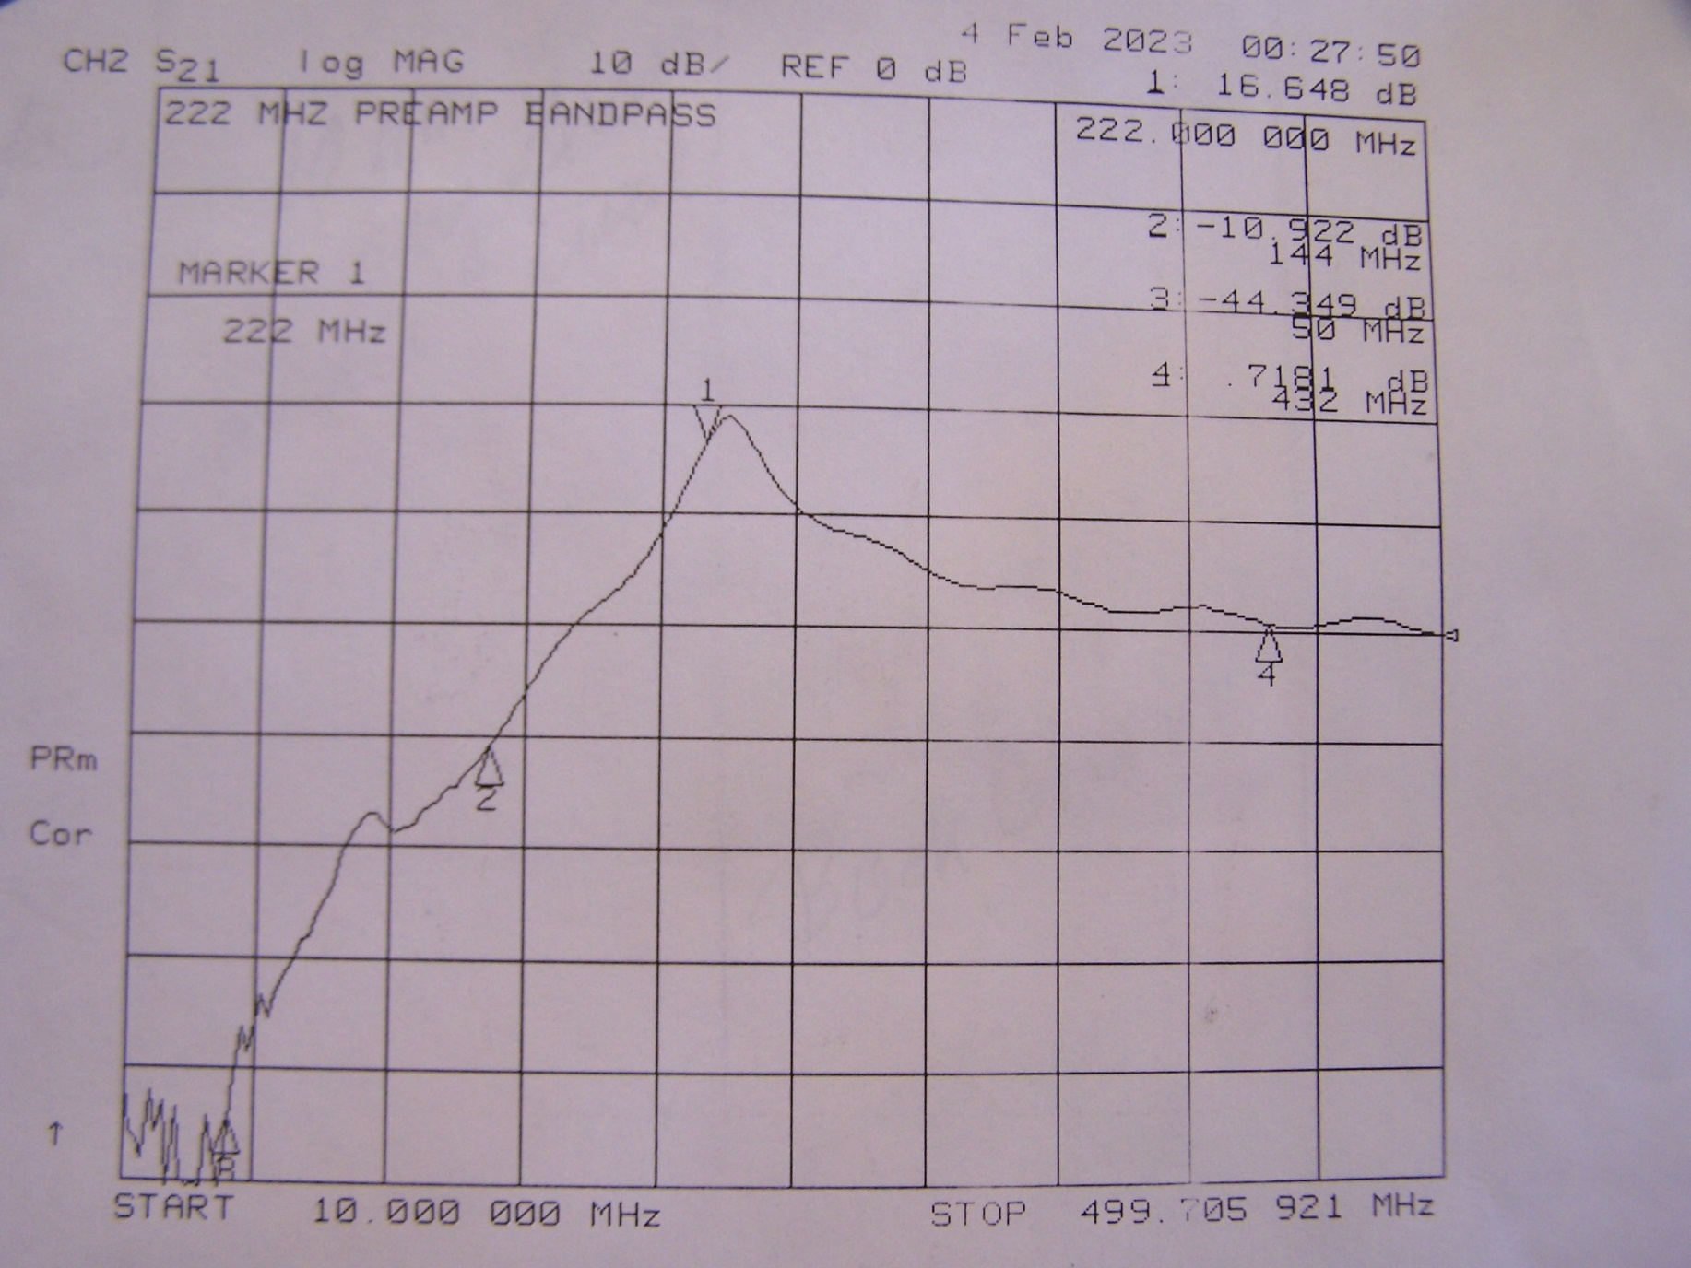
HB Gasfet preamp bandpass with silver plated coil input circuit.

Slide 16
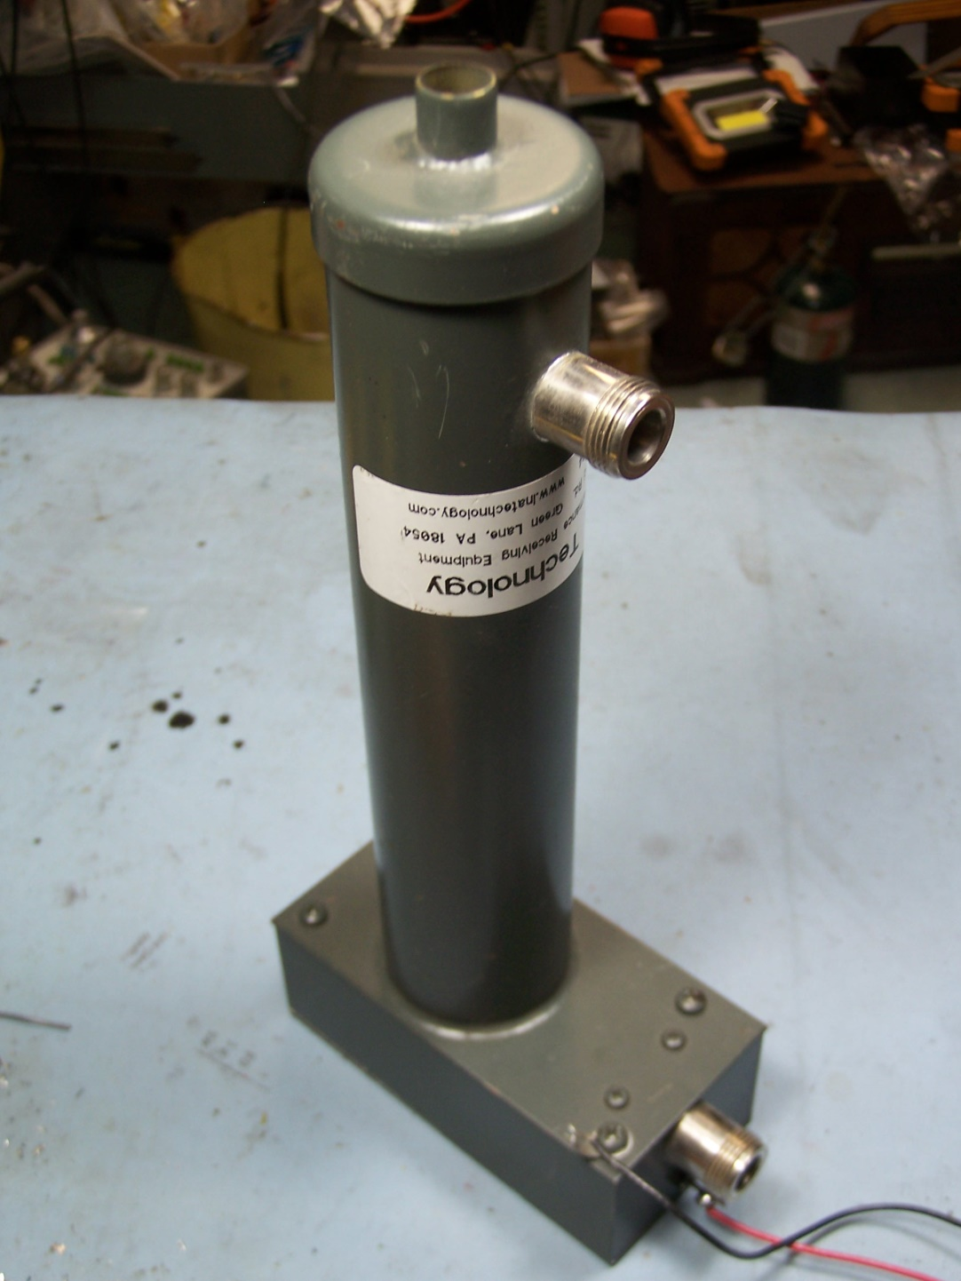
LNA TECHNOLOGY Cavity Preamp for 222 MHz.

Slide 17
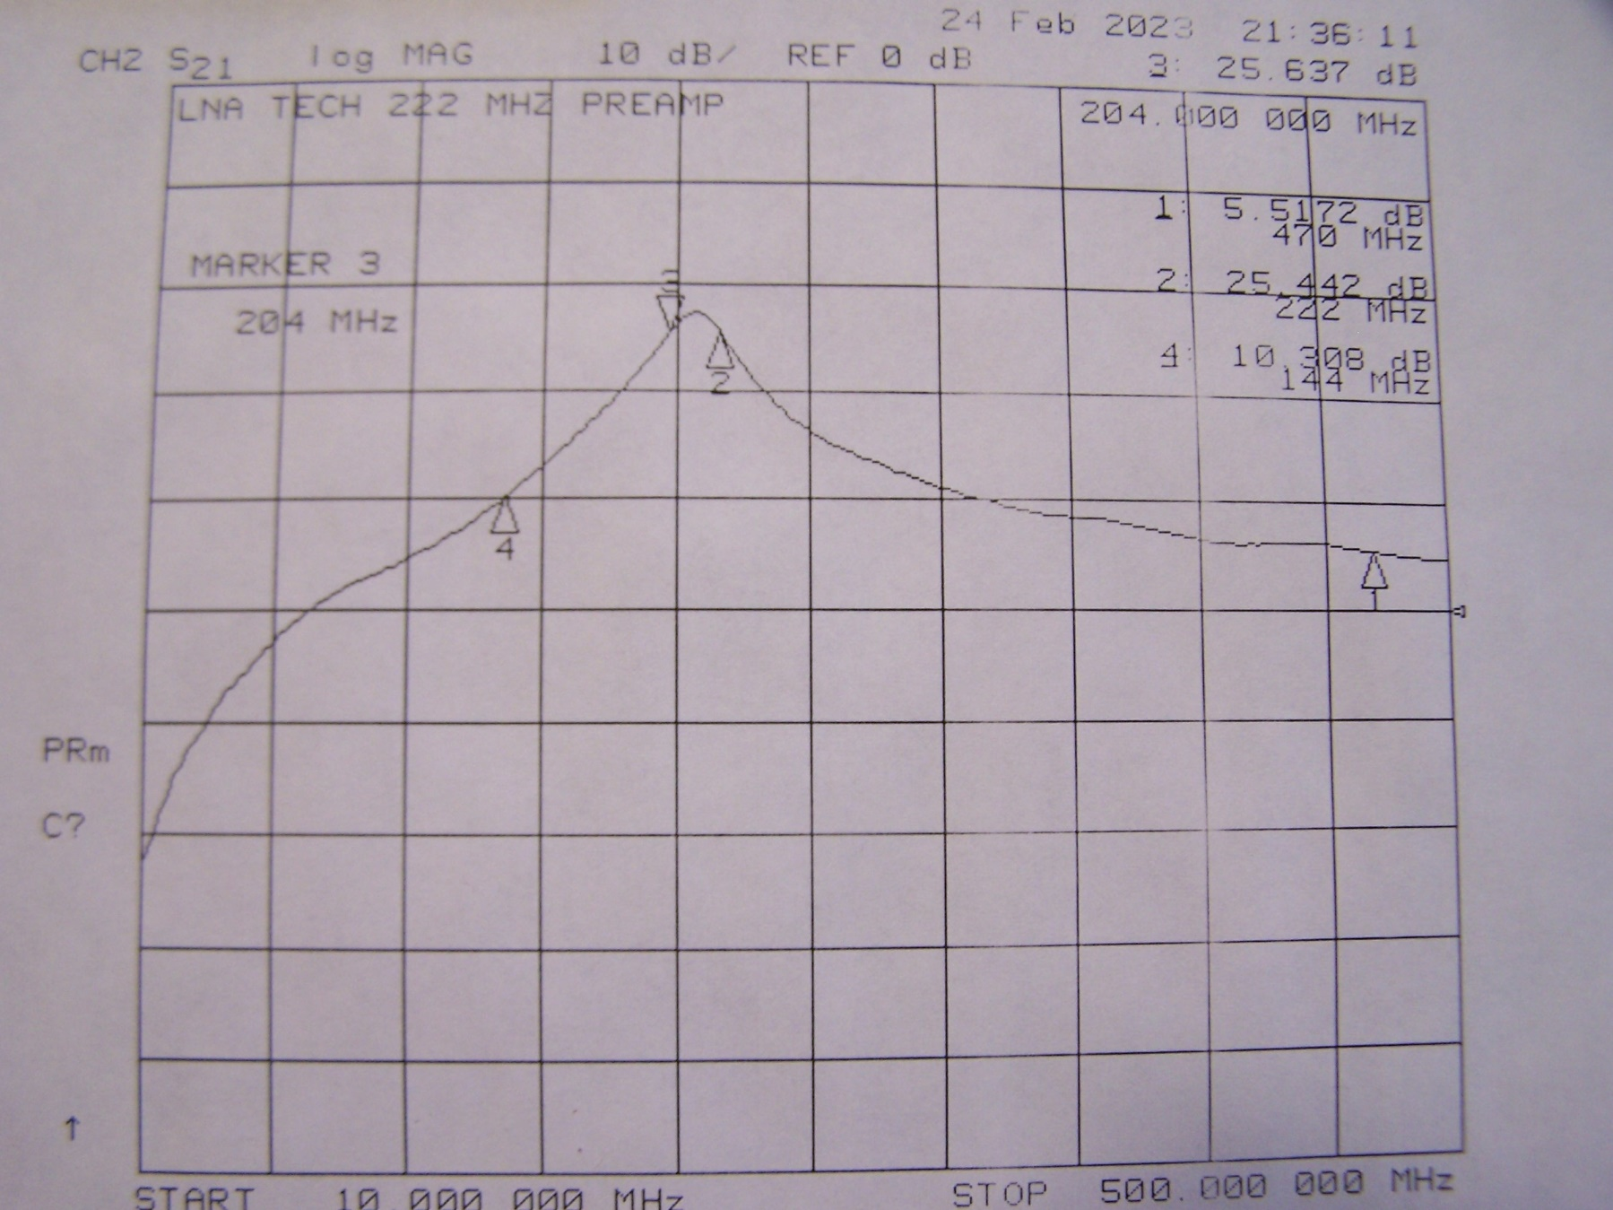
LNA Technology Cavity Preamp Bandpass plot. Too much gain & low selectivity
25.5 dB gain at 222 MHz, 25.5 dB gain at 204 MHz! 5,5 dB gain at 470 MHz

Slide 18
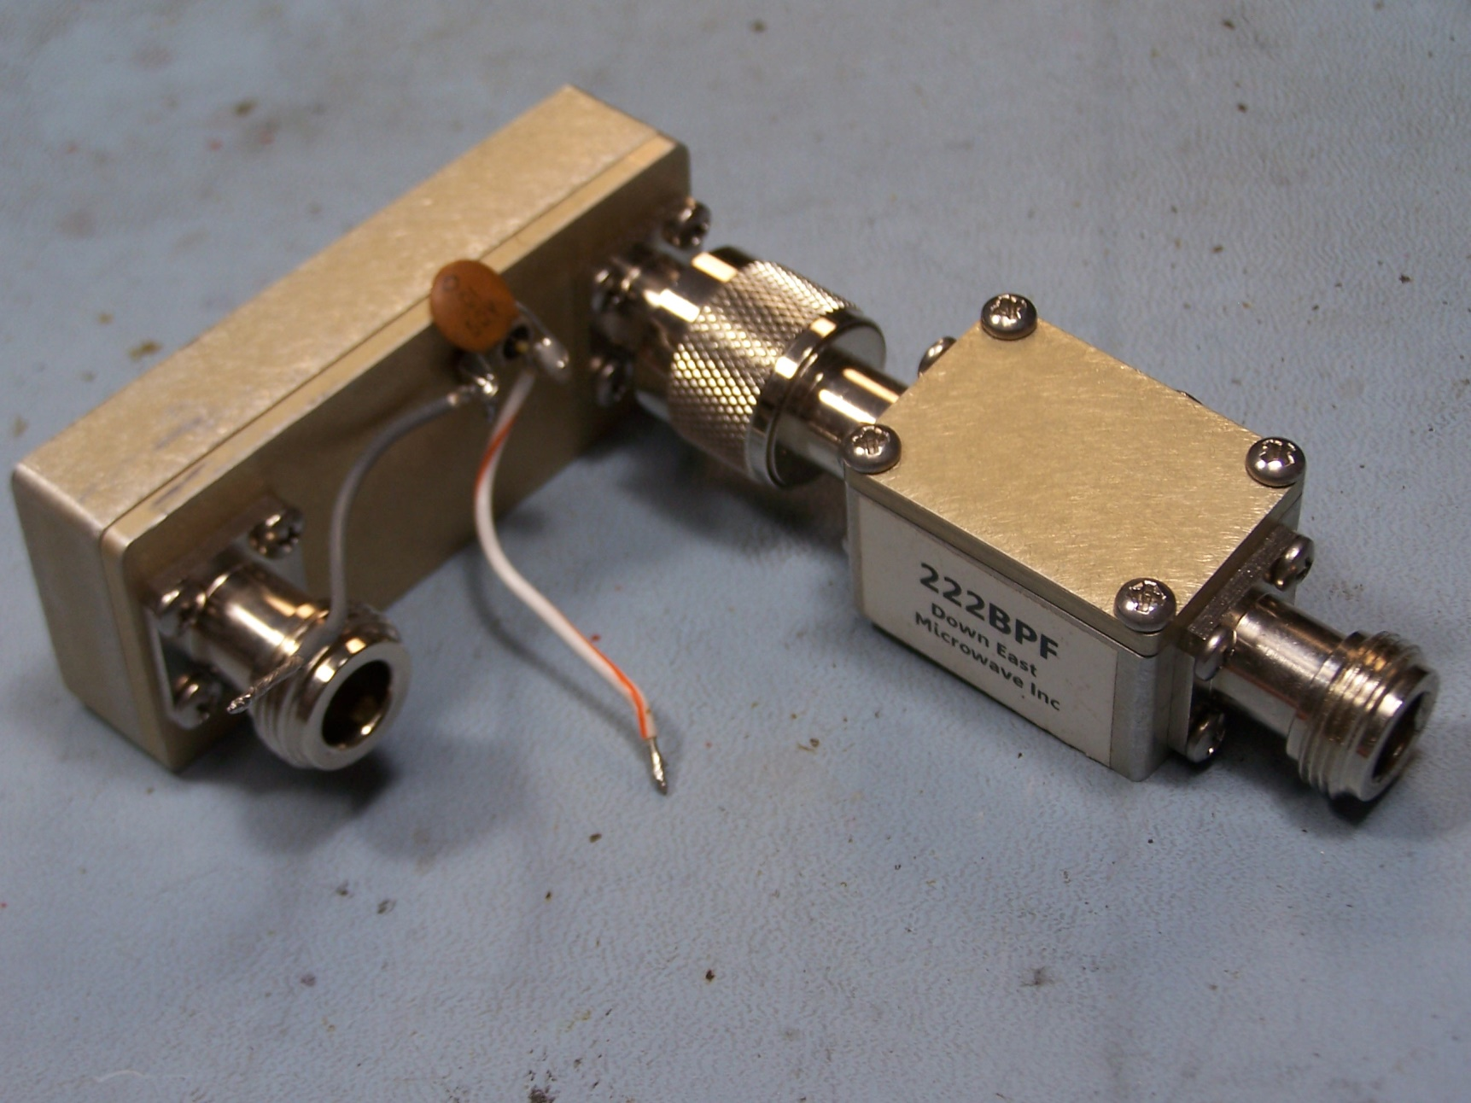
Here is a DEMI high dynamic range 222LNA with SAW filter output

Slide 19
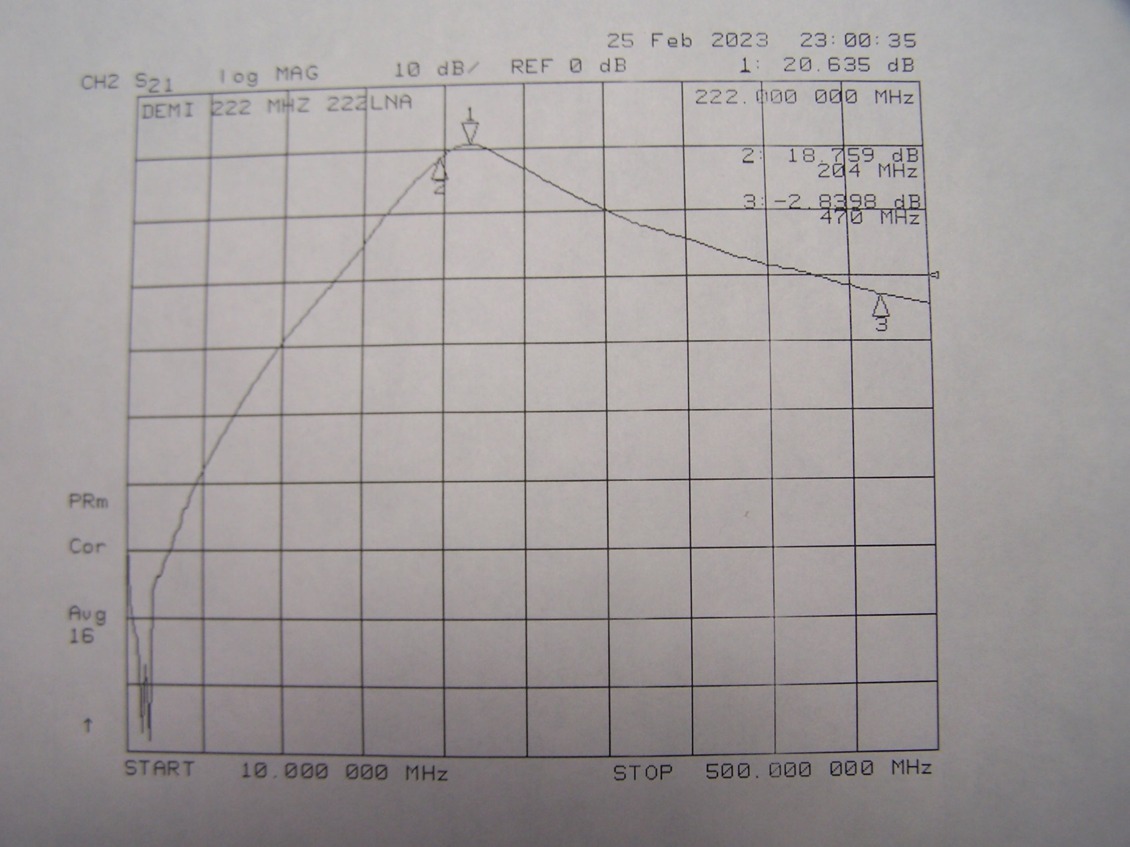
DEMI 222LNA Preamp passband without the SAW filter

Slide 20
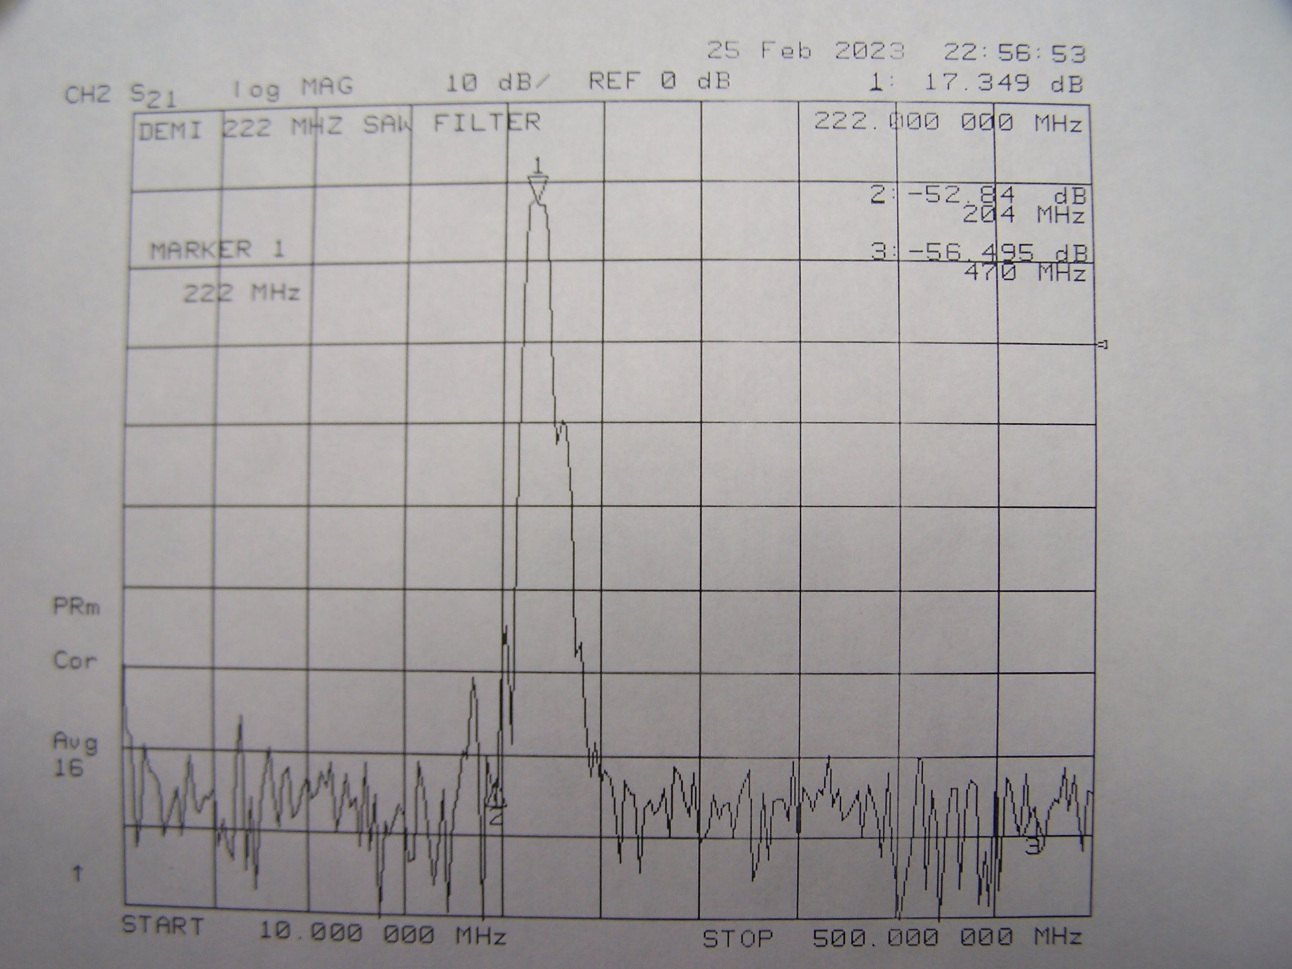
DEMI 222LNA SAW Filter passband. Gain @ 222 MHz is 17 dB.

Slide 21
TELEVISION INTERMOD EXAMPLES
VHF TELEVISION INTERMOD 2f2 - f1 or 2f1 - f2
2 x CH 13 – CH12 = 222 MHz
2 x CH 11 – CH 8 = 222 MHz
2 X CH12 – CH 10 = 222 MHz
UHF TELEVISION INTERMOD 2f2 – f1 or 2f1 – f2
2 x CH 14 – CH21 = 431 MHz (mid band)
2 x CH 15 – CH23 = 431 MHz (mid band)
2 x CH 20 - CH 32 = 428- 440 MHz (affected frequencies)
A high IP3 solid state device might have IMD products down 80 to 100 dB, but if your frontend provides high gain at television frequencies, then even small amounts of IMD can raise the noise floor.

Slide 22
The Bottom Line
You have to determine which solution is best for your station.
A Typical Tropo Station looks at a 300 K+ horizon. You can tolerate some filter loss. Put a filter ahead of your front end if you have TV overload
An EME system not made for use on the horizon might need no filtering at all.
A combo Tropo & EME station is difficult! You need extremely low NF but good filtering.

Slide 23
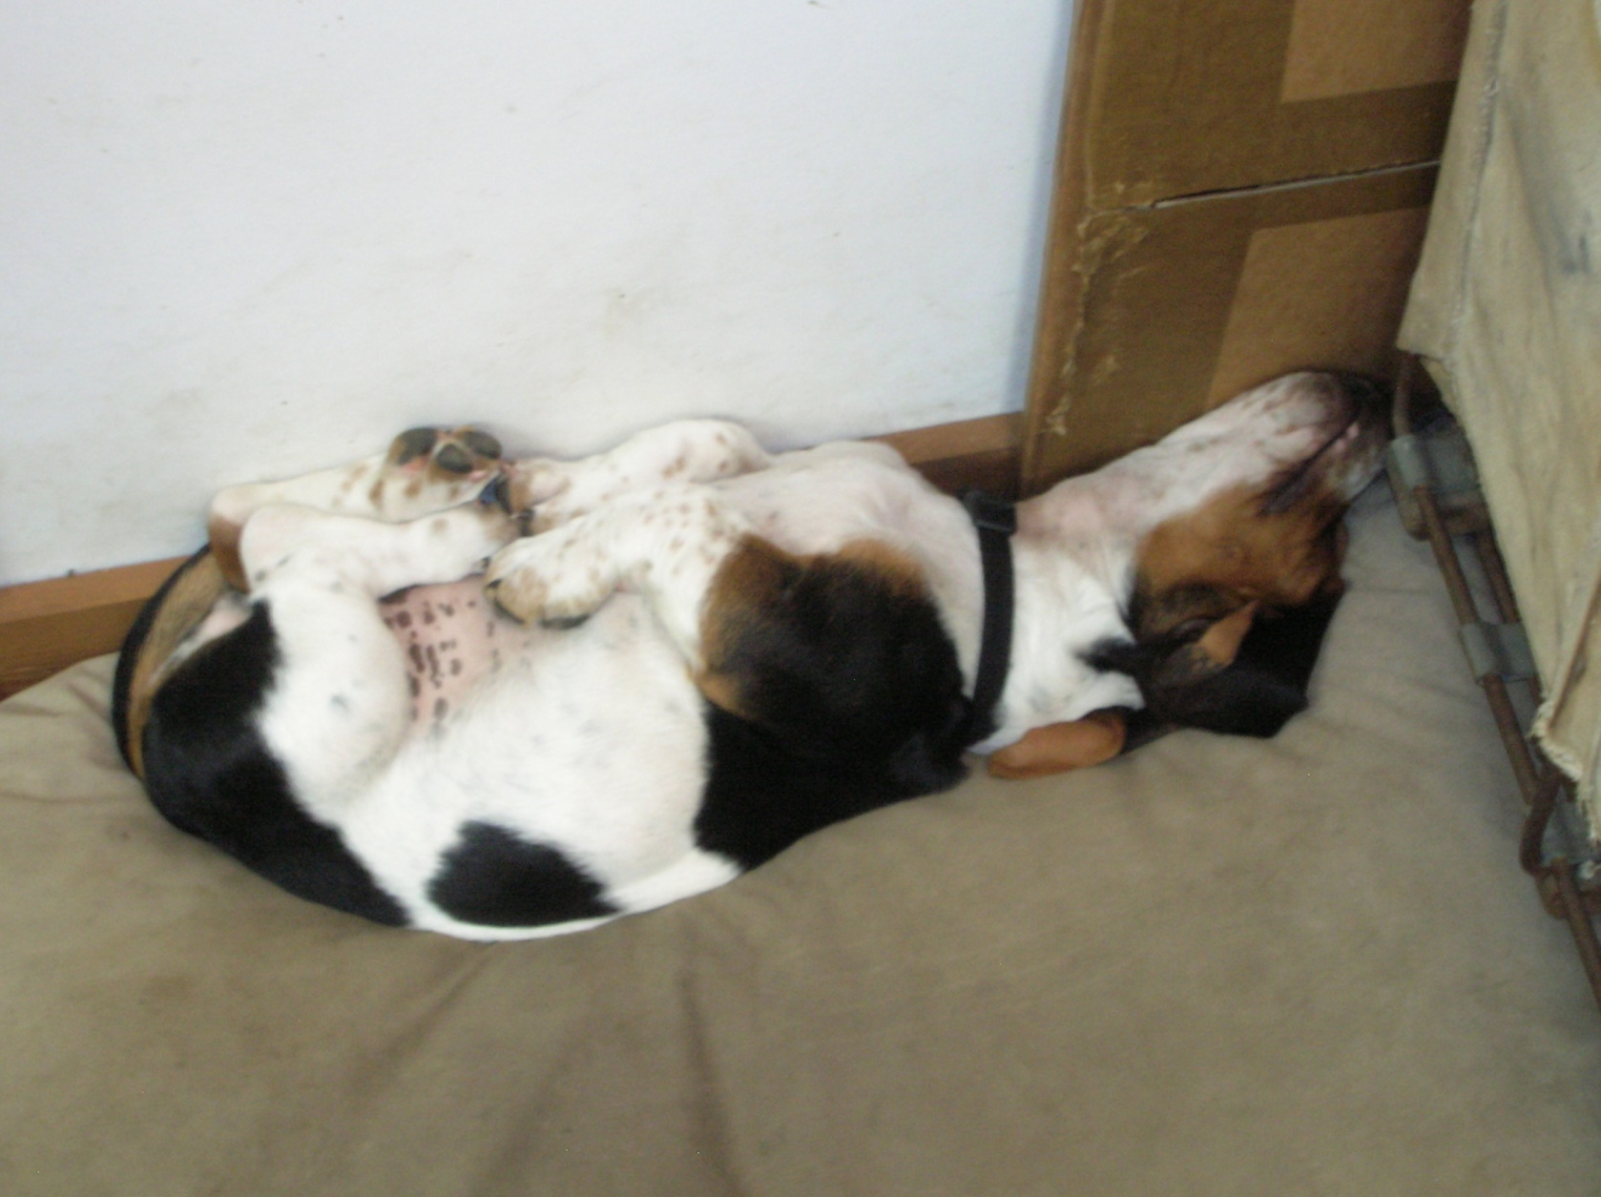
That’s it, I am Done!

