Slide 1
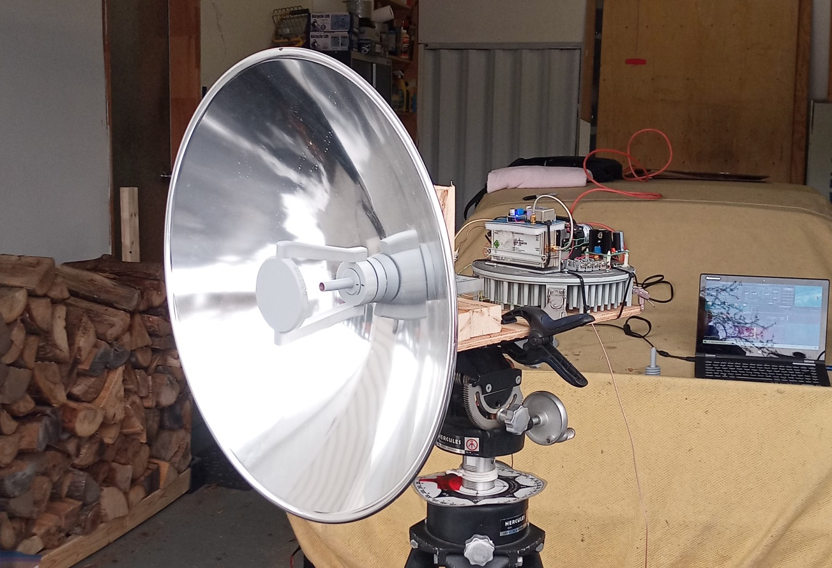
3D Printed 47 GHz Cassegrain Antenna
Rene Barbeau
VE2UG 2023

Slide 2
Need for gain
1FT antennas are common, 2FT rare and expensive.
VA3ELE uses 2FT with great success.
We asked Paul W1GHZ if he can come up with a design for 47 GHz.
2FT Edmund Optics reflectors are available and inexpensive.
We had good success with 1FT at 122 GHz, let’s try 47!

Slide 3
Paul Wade W1GHZ design
Cassegrain feed and subreflector.
Signal from back, K&S #8129 brass tube feed (3/16, 0.014 wall).
Large aperture W2IMU, can be bored with #5 center drill.
Matched to either 4 or 5 inch subreflector.
Settled to 4 inch, easier to print.

Slide 4
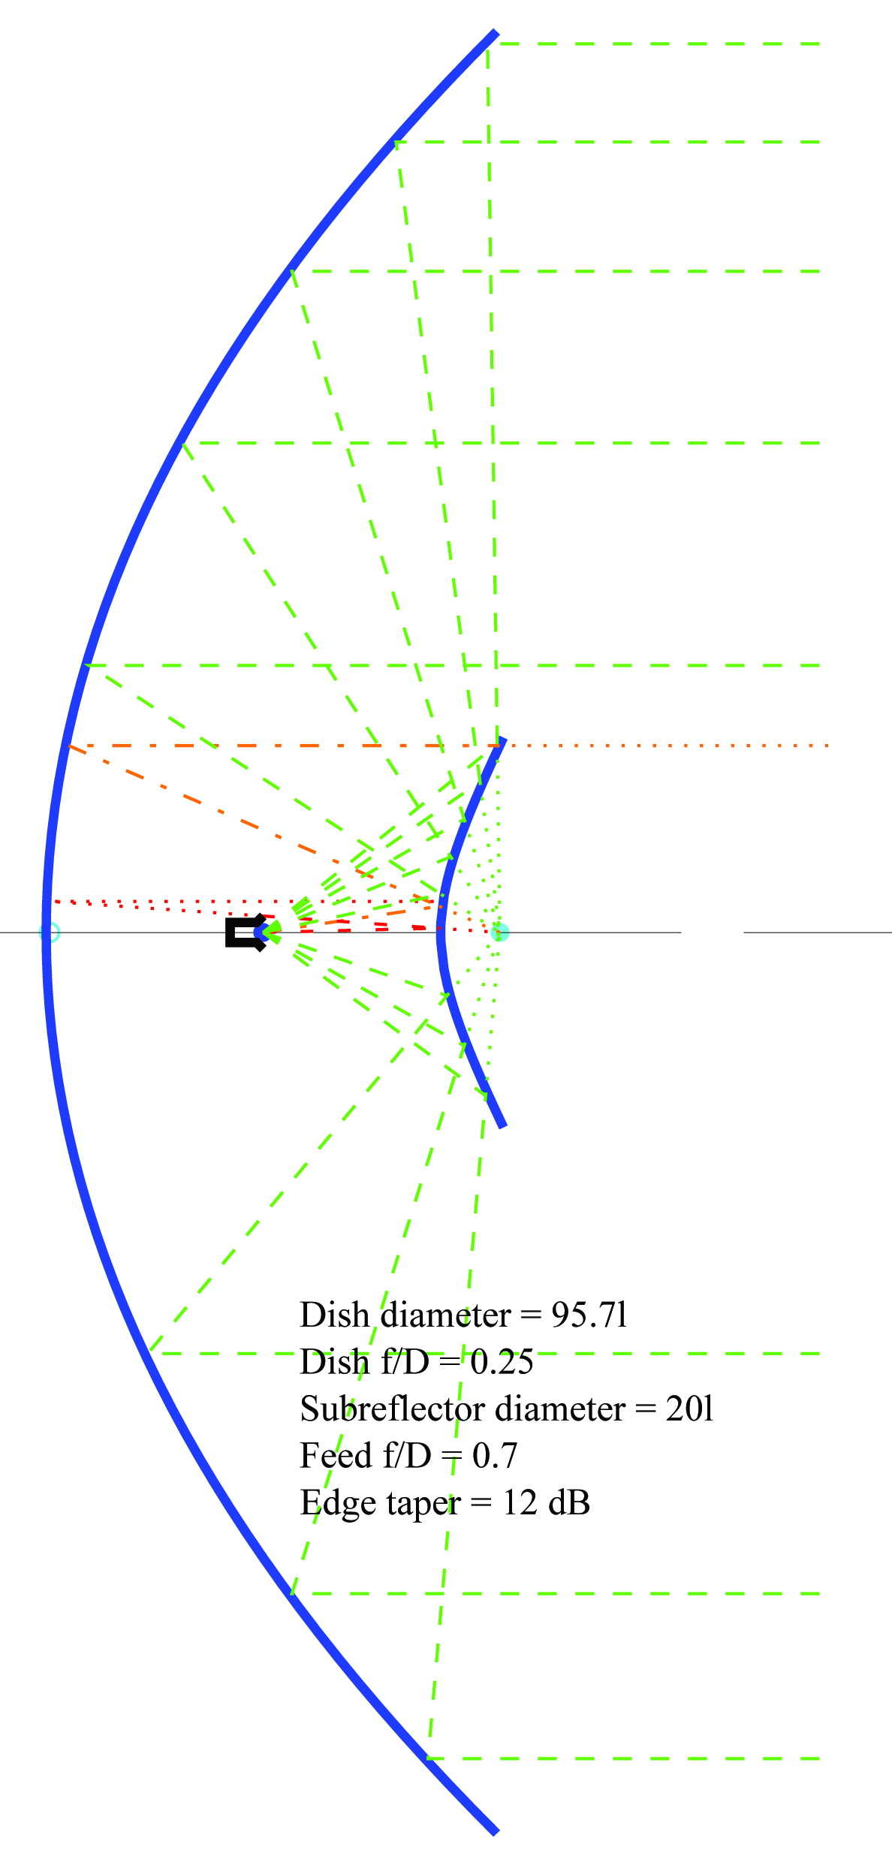
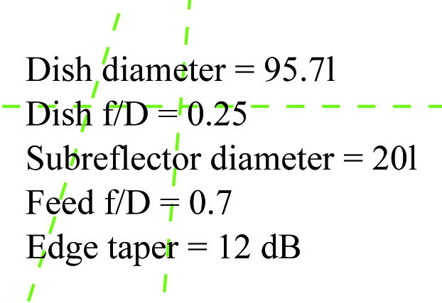
Paul Wade W1GHZ design
Vertex to feed phase center = 89mm.
Vertex to subreflector = 135.9mm.

Slide 5
Metal vs Plastic
Paul built a metal feed and CNC subreflector.
I do the same with 3D printing.
Reflective part covered with aluminum duct tape. Feed interior with conductive paint.
Will be compared on antenna range.

Slide 6
3D Print Design
Done on Fusion360.
Steep learning curve. I know maybe 1% of it. Enough for simple parts.
Material is PETG for heat resistance.
PLA will melt in a hot car. True.
3 parts:
Reflector mount/feed.
Subreflector.
Lock nut.

Slide 7
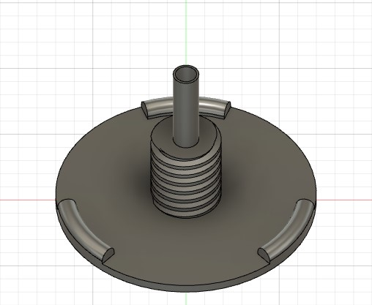
Reflector mount and feed

Slide 8
Reflector mount and feed
3 points support.
Acme thread.
Shoulder on thread to align reflector.
W2IMU design. Large diameter length 3.7λ.
Feed distance adjusted from design.
Feed interior painted with 3 coats of MG Chemicals 843WB Super Shield Conductive Paint.

Slide 9
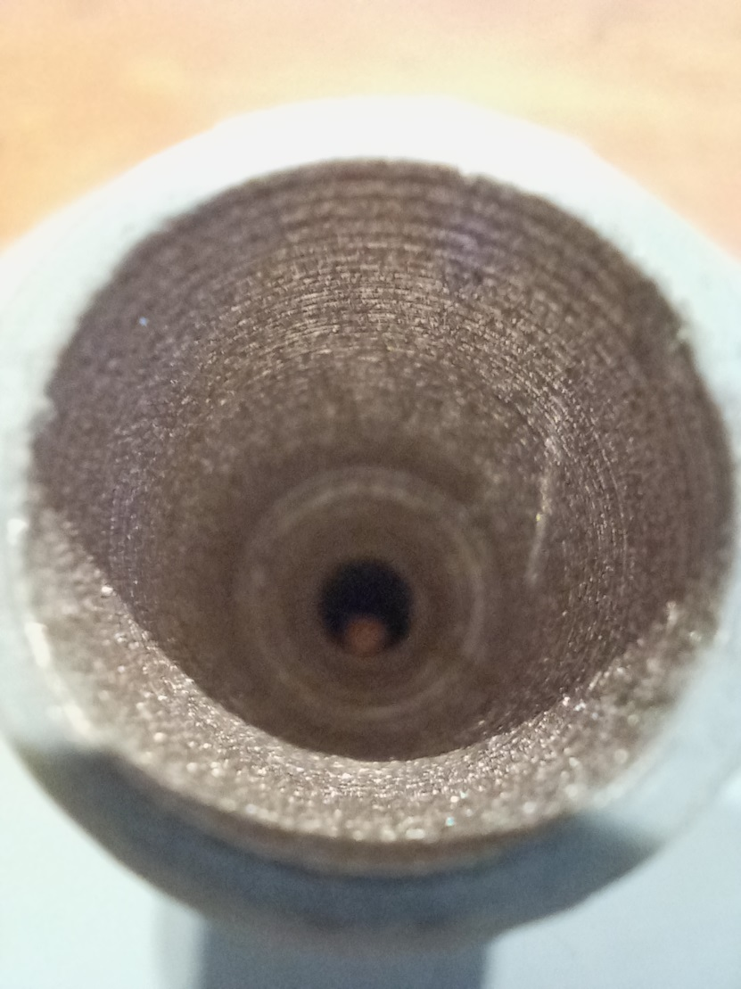
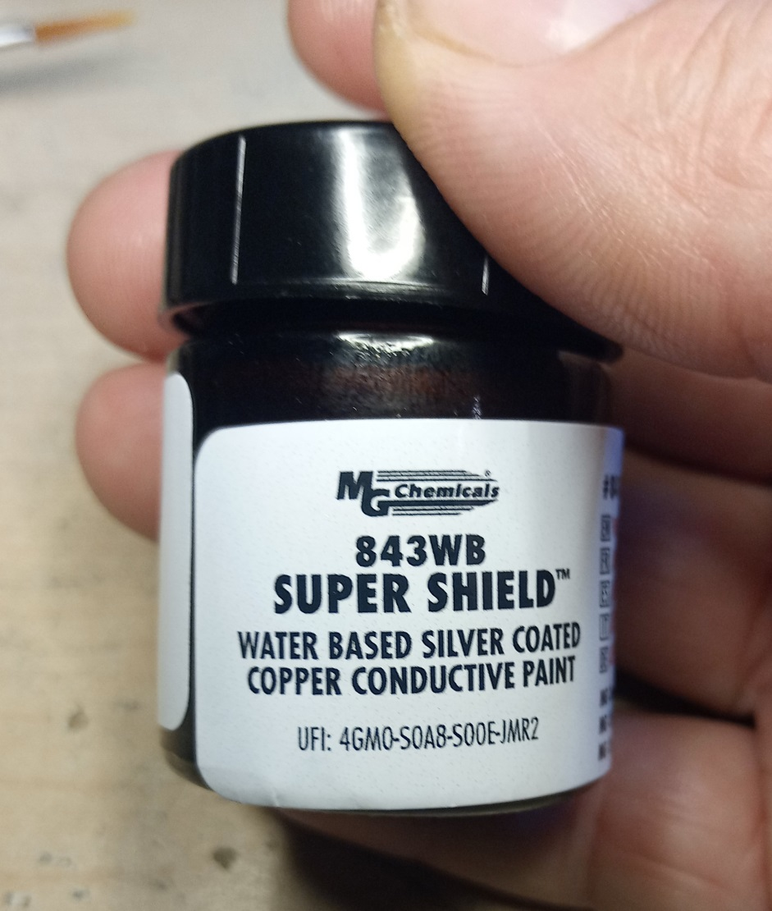
Inside of feed, paint

Slide 10
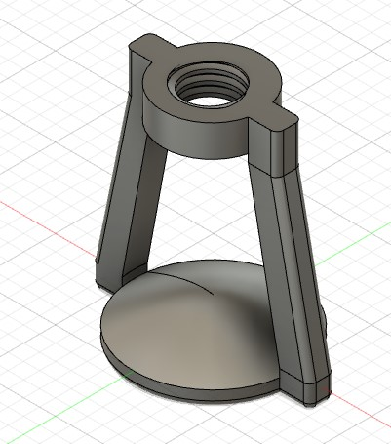
Subreflector

Slide 11
Subreflector
Simulated hyperboloid.
Close to CNC dimension (fraction of mm).
Printed with arms horizontal, for strength.
Thread size scaled +4% X-Y for fit.
Necessary to account for filament spread during print.
Covered with aluminum duct foil.

Slide 12
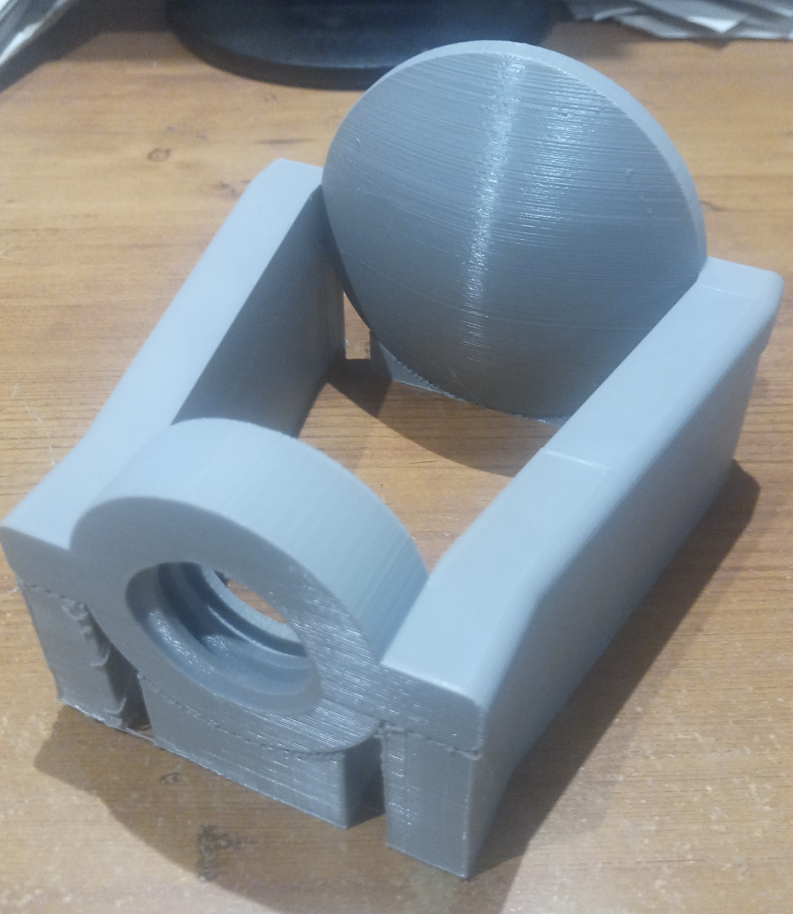
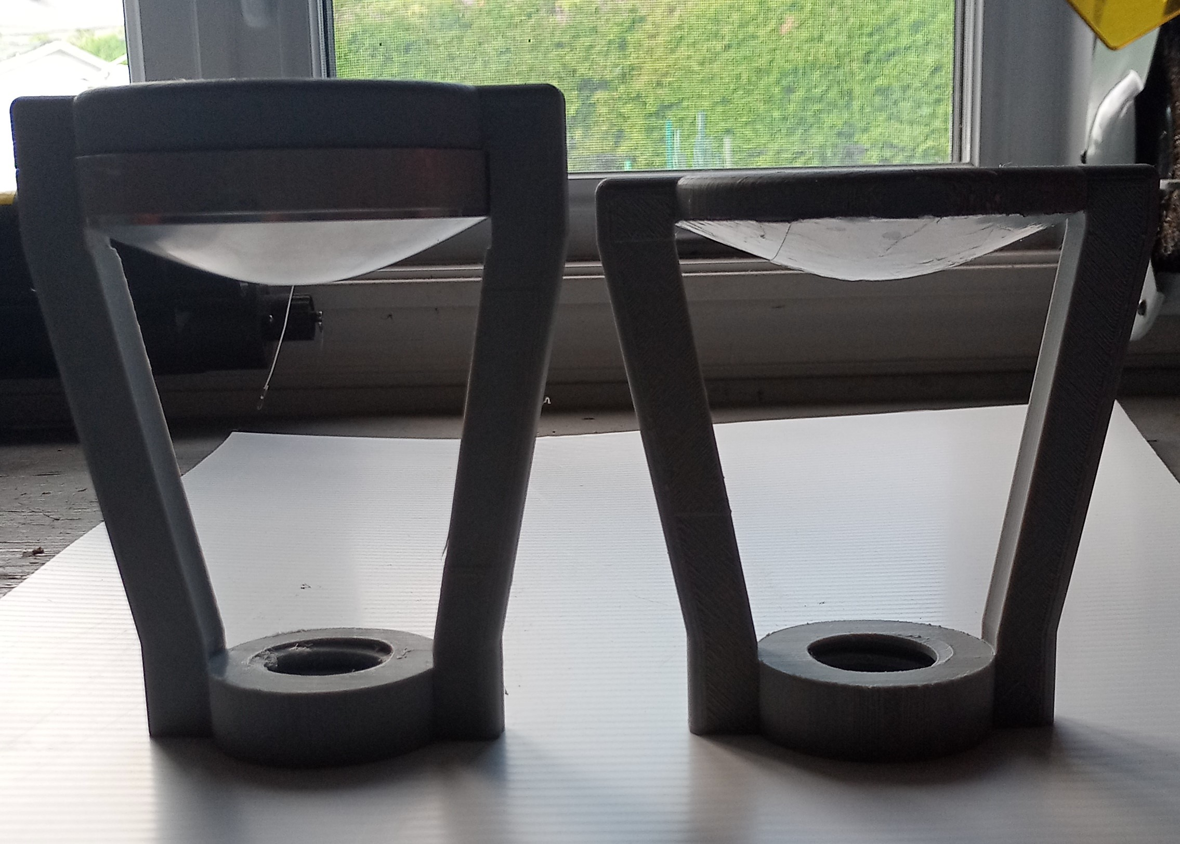
Subreflector, metal and plastic

Slide 13
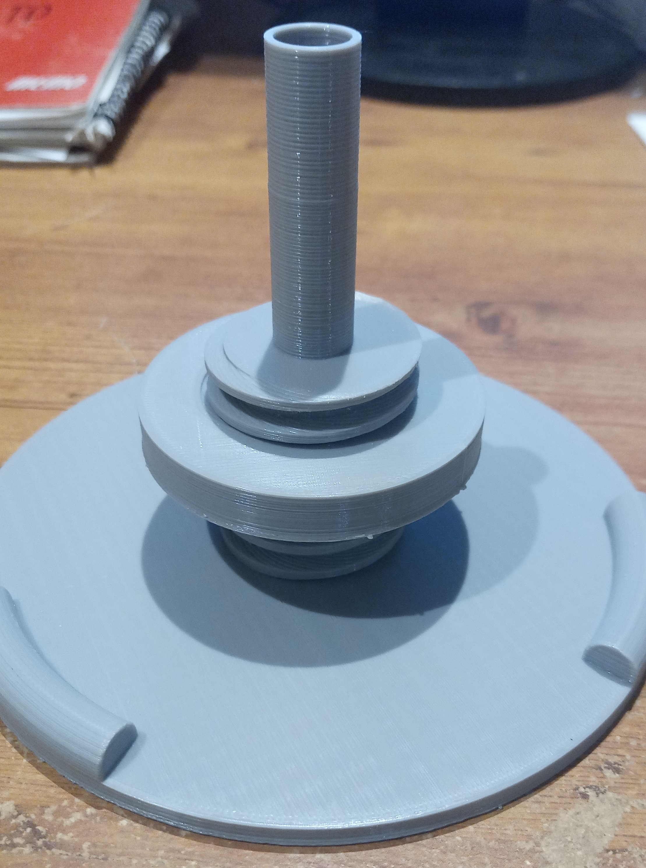
Lock Nut
Straightfoward design.
X-Y scaled +4%.
15mm thick for tests. Final 18mm.
Subreflector is screwed over it. No adjustment.

Slide 14
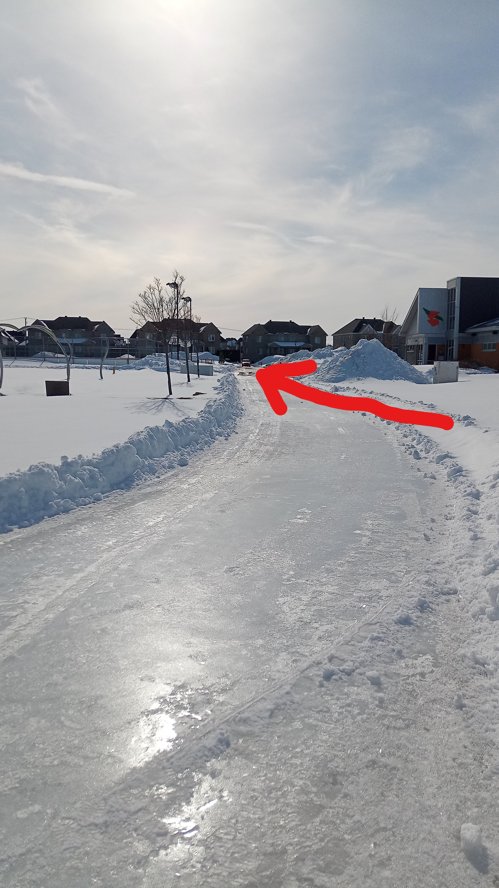
Antenna range
Rayleigh distance for 2FT dish is 106M.
I found a site with 120M, not trivial in winter.
Barely into far field.
I plan to redo the test at longer range in summer.

Slide 15
Source and receiver
Weak signal source from Elcom synth, PCOM RX converter and horn.
Receiver is Khune transverter + RSPdx and SDRuno.
Tried SDR Console but RSL is too unstable +-0.5 dB.
SDRuno stay within +-0.1 dB, and track my HP generator within 0.1 dB.

Slide 16
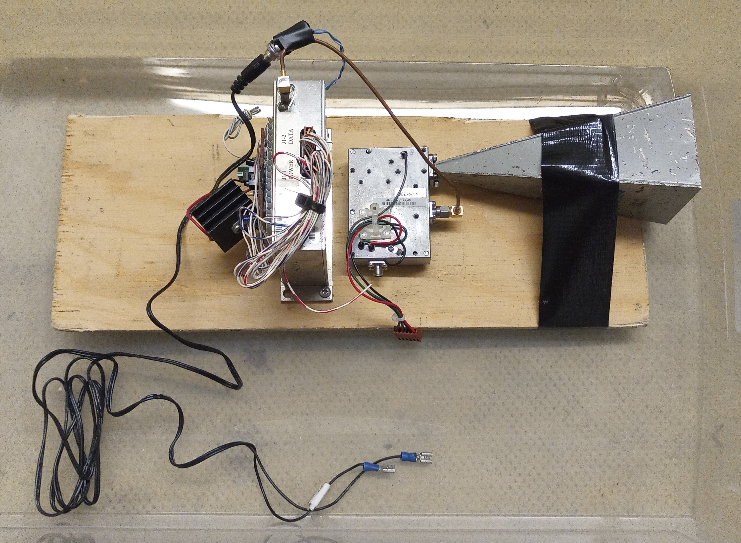
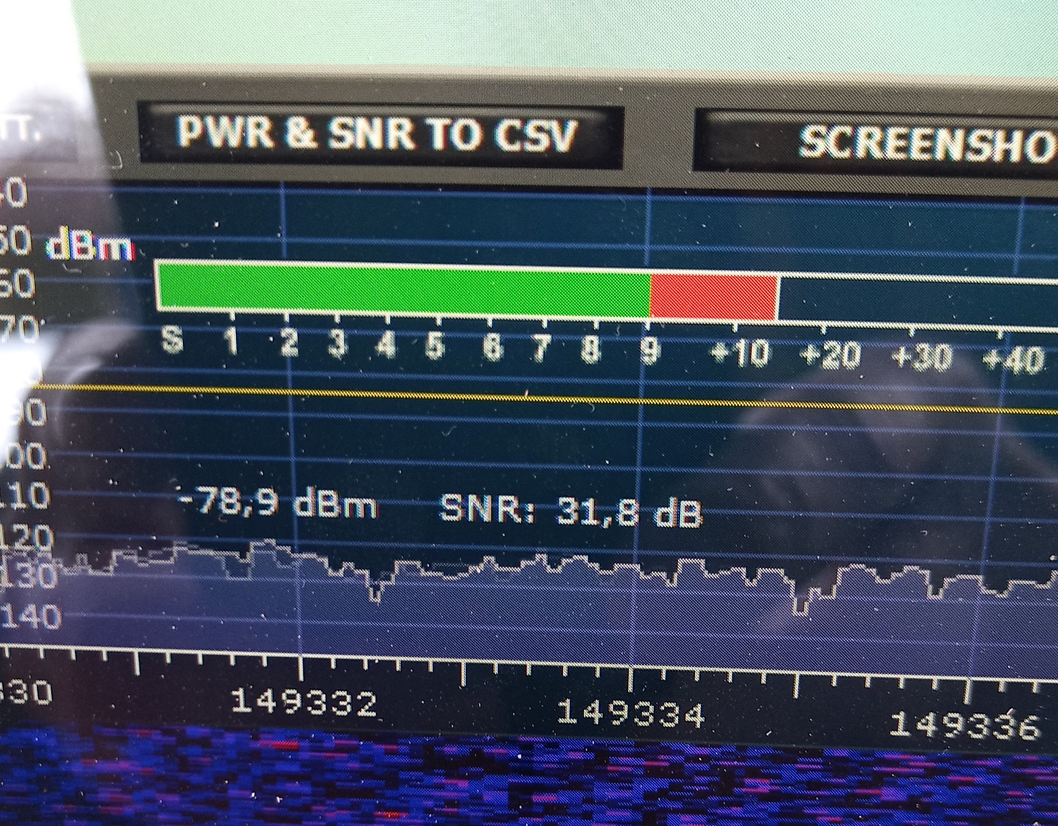
Weak source and SDRuno

Slide 17
Test Method
Measure signal with feed only.
Then add subreflector and measure difference.
Feed gain alone is around 14 dBi.
Antenna gain = 14 + signal increase.

Slide 18
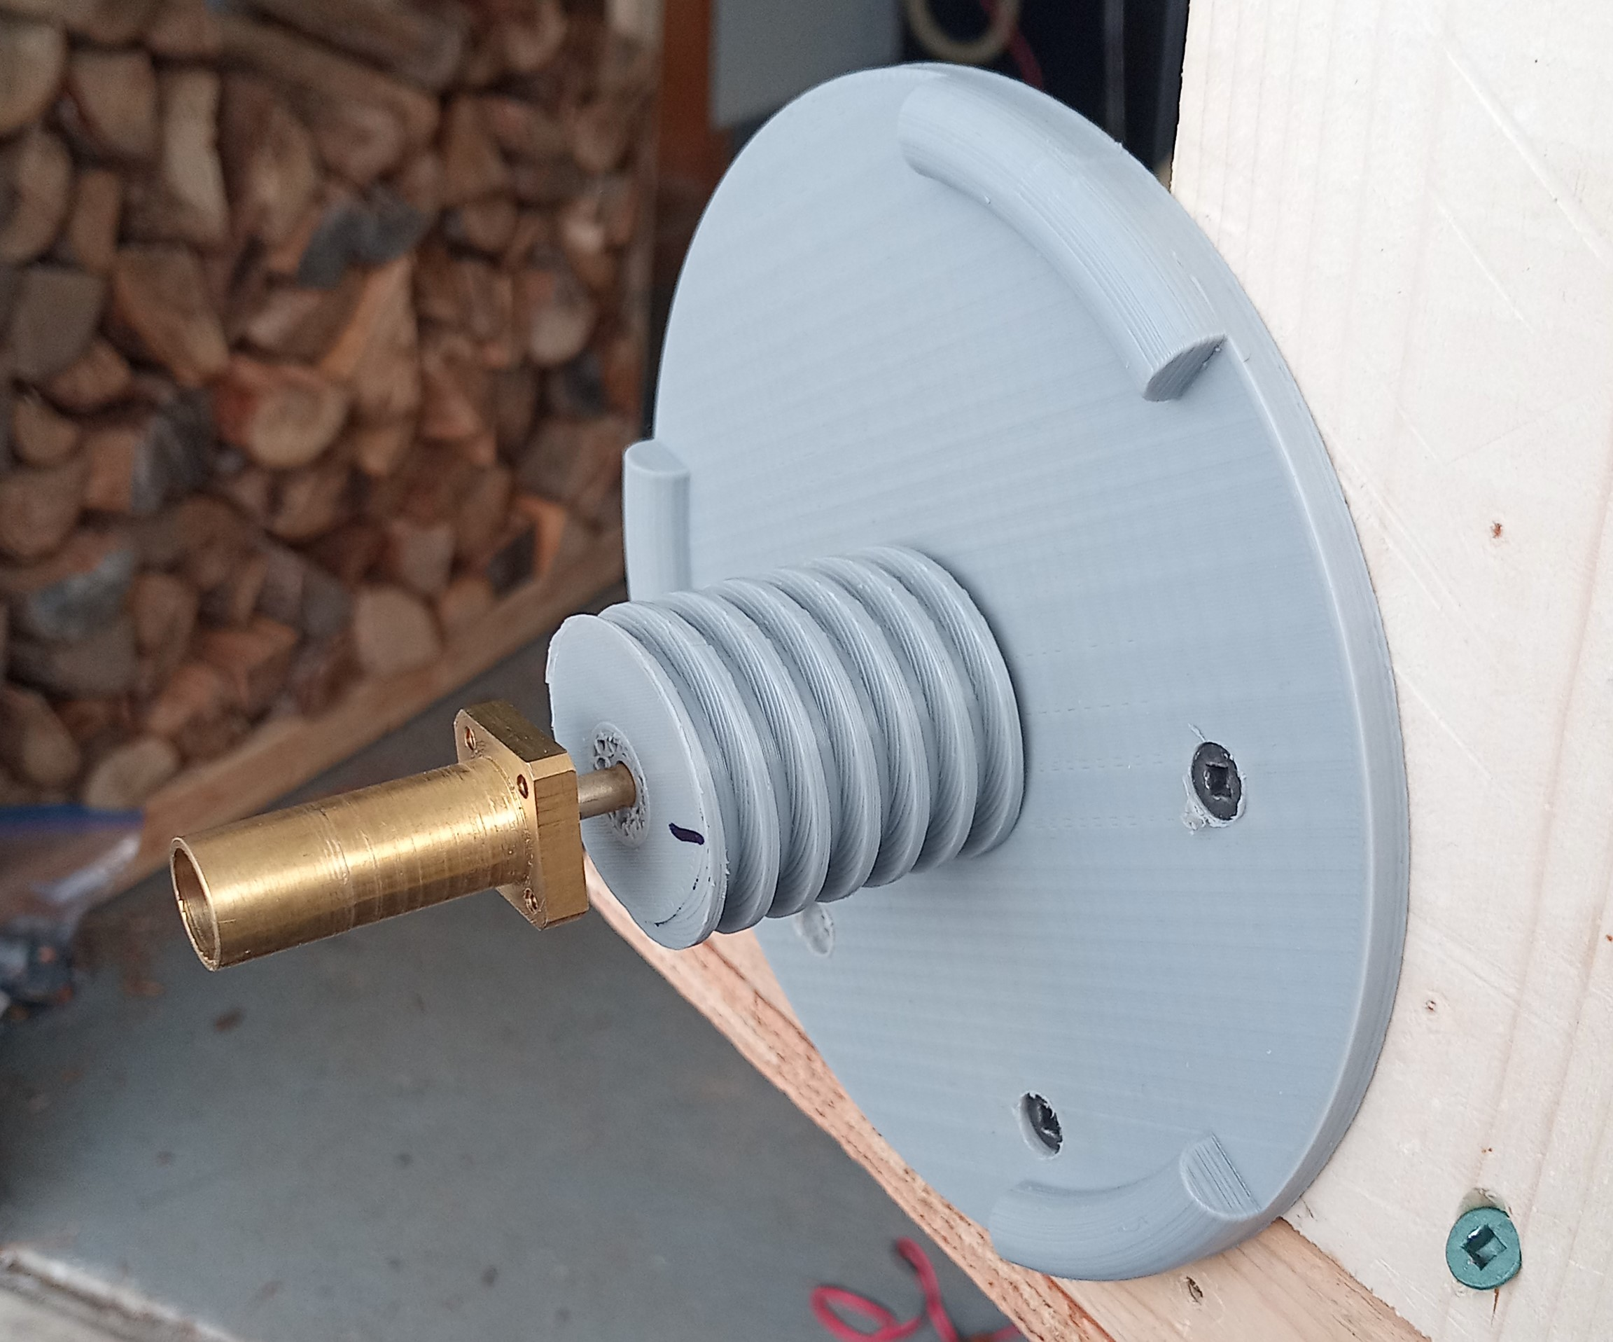
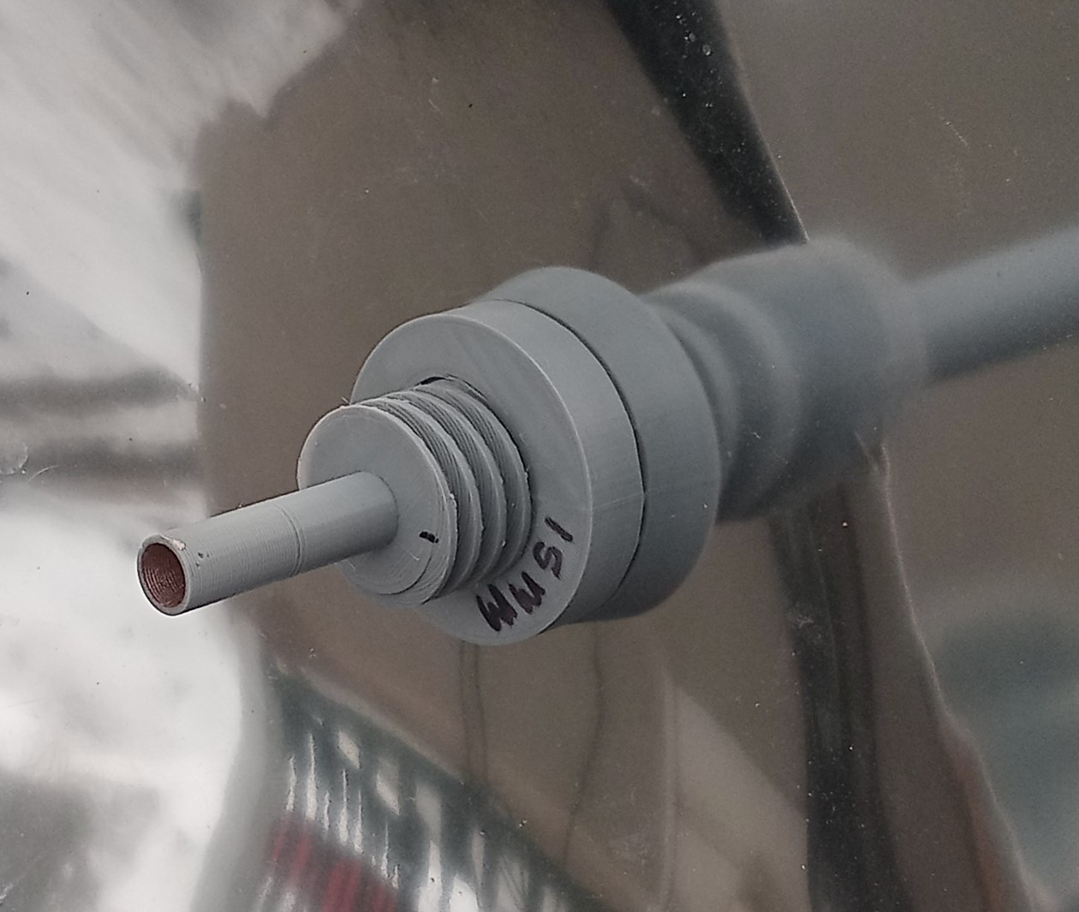
Plastic vs Metal
We can compare bare feeds.
Also signal increase between subreflectors, for each type of feed.

Slide 19
Test results, bare feeds
Metal feed = -92.6 dBm.
3D feed = -94.5 dBm.
Plastic is -1.9 dB less than metal.
Could be the paint conductivity and/or surface roughness.

Slide 20
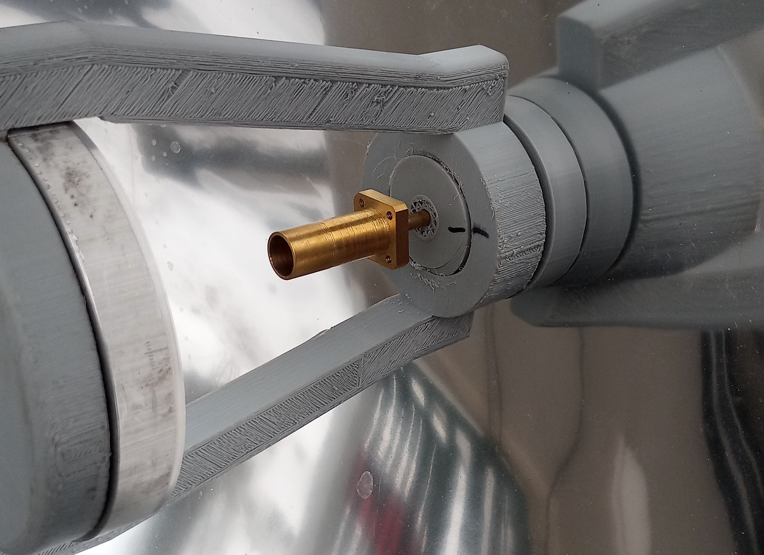
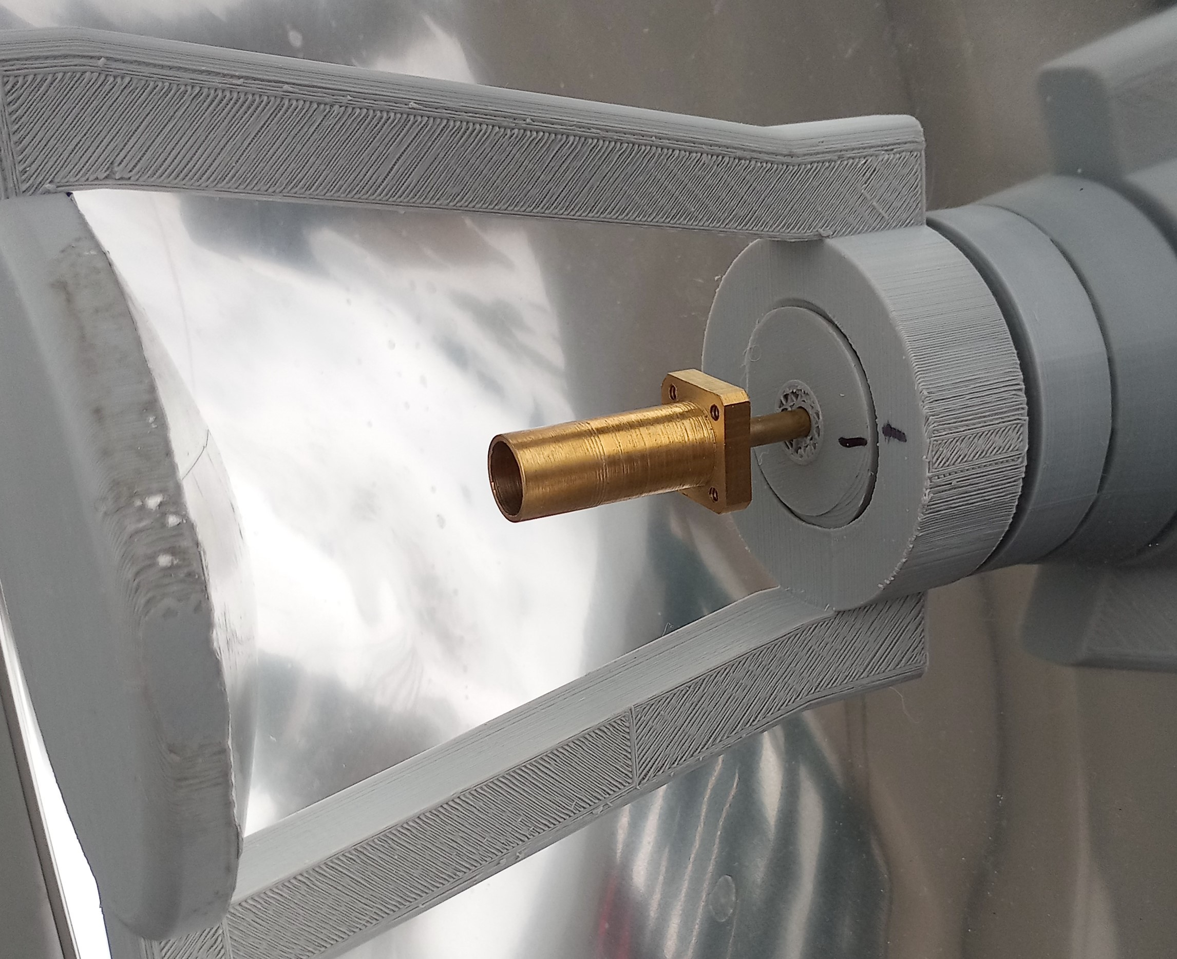
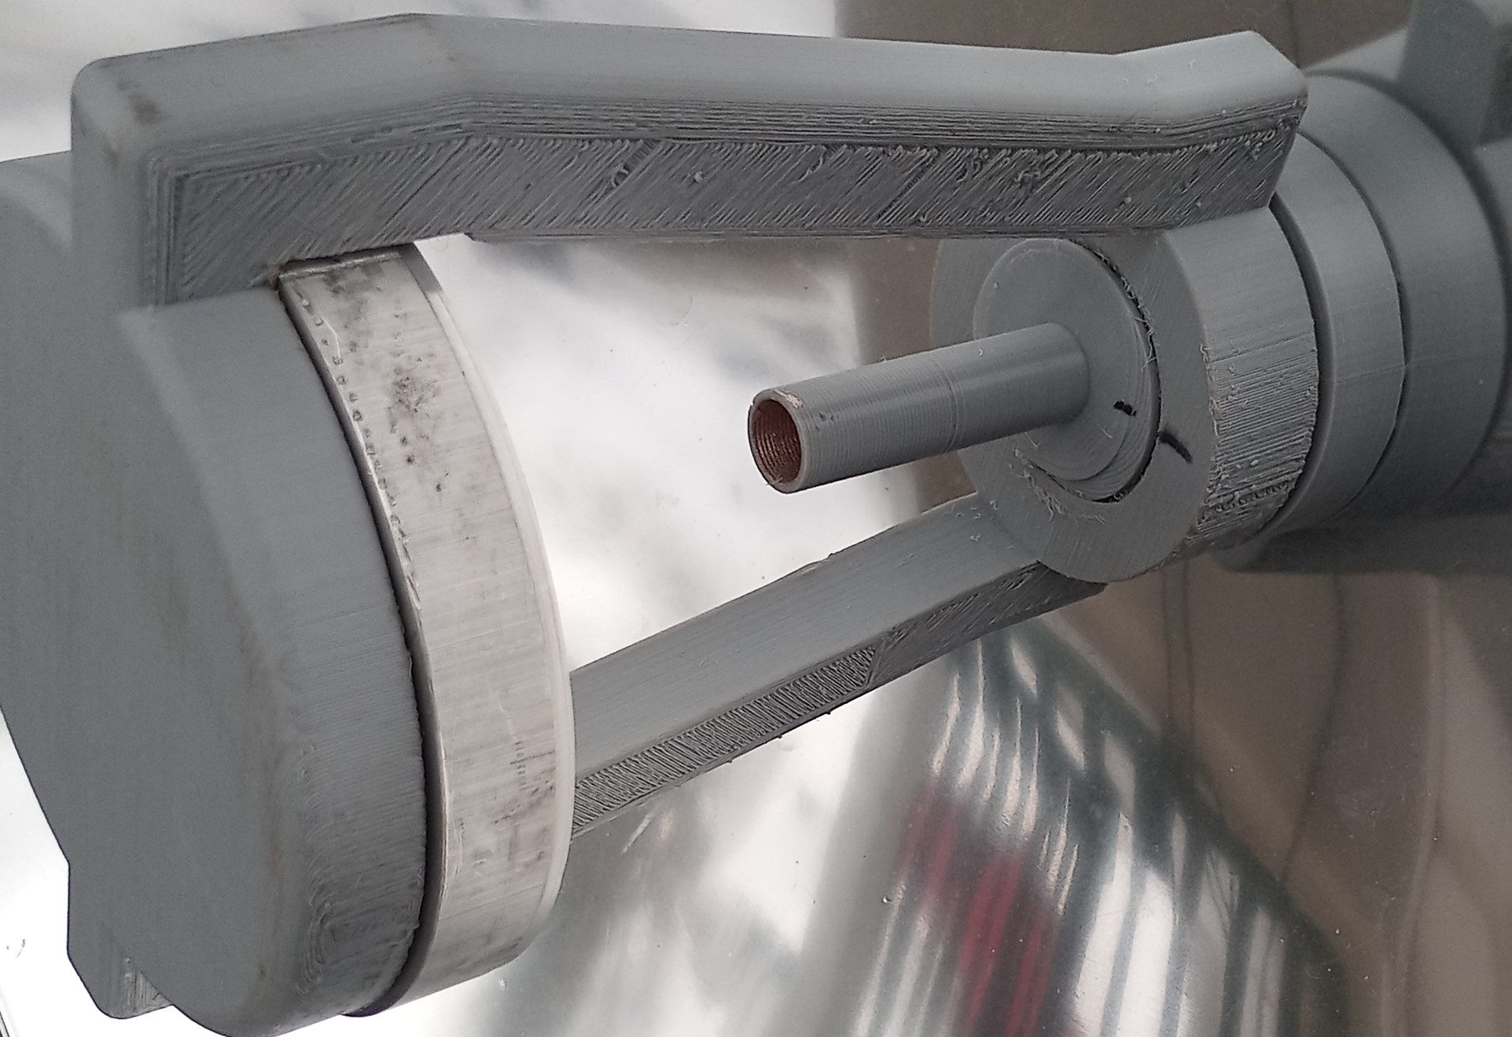
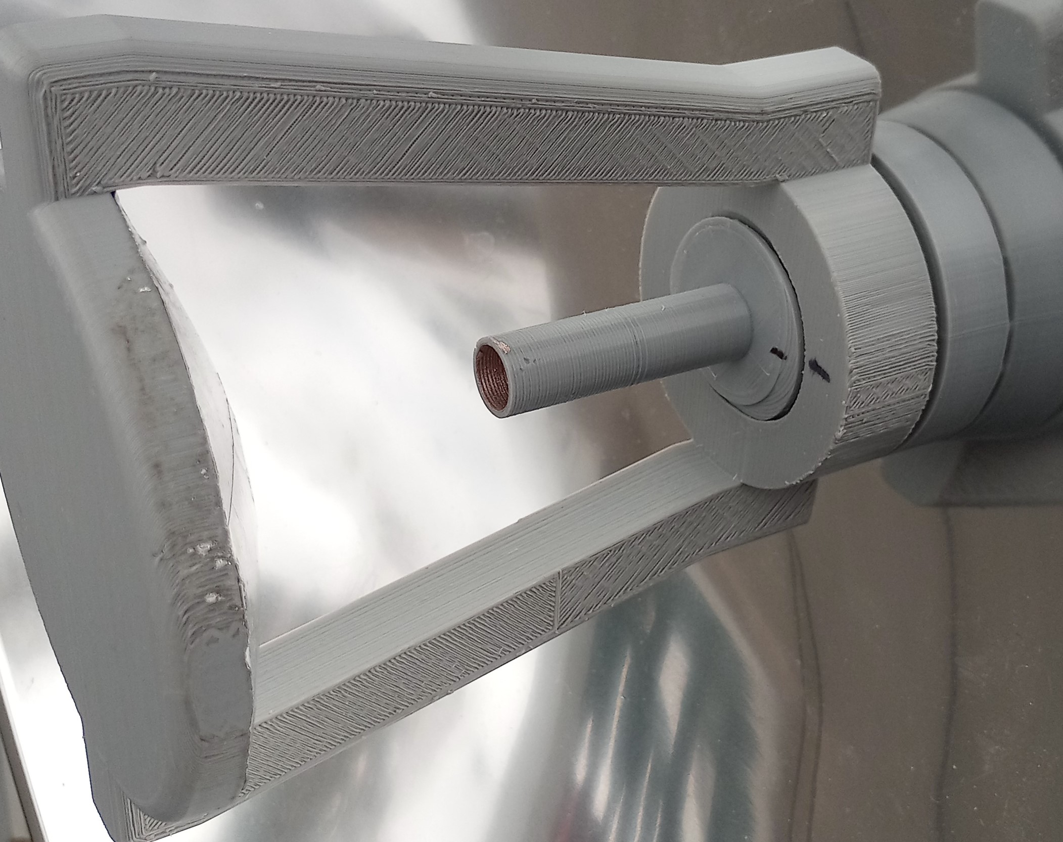
Metal vs 3D subreflectors

Slide 21
Test results, subreflectors
Baseline is -92.6 dBm.
Metal feed + CNC sub. = -60.9 dBm (+31.9 dBr).
Metal feed + 3D sub. = -60.9 dBm (+31.9 dBr).
Baseline is -94.5 dBm.
3D feed + CNC sub. = -62.6 dBm (+31.9 dBr).
3D feed + 3D sub. = -62.3 dBm (+32.2 dBr).

Slide 22
Test results, whole antennas
Base feed estimated at 14 dBi.
Metal feed + CNC sub. = 45.9 dBi.
Metal feed + 3D sub. = 45.9 dBi.
Plastic feed + CNC sub. = 45.9 dBi.
Plastic feed + 3D sub. = 46.2 dBi.
NOTE: Resistive, surface loss will lower your RSL.

Slide 23
Antenna efficiency
Calculated with antenna diameter of 58cm.
Metal feed + CNC sub. = 47%
Metal feed + 3D sub. = 47%
Plastic feed + CNC sub. = 47%
Plastic feed + 3D sub. = 51%
Resistive/surface loss ommited.
47 - 51 % efficiency at 47 GHz is pretty good!

Slide 24
Source of loss, plastic feed
More coats of paint? Maybe.
Better paint? MB Chemicals have other products.
Surface roughness? Feed internal diameter could be printed smaller and finished with a #5 center drill.

Slide 25
Conclusions
CNC and metal subreflector are the same.
While I find a solution for 3D plastic feed loss you can use a metal feed.
Print the mount and snap the plastic feed off. You will have to adjust the feed to subreflector distance.
Still, only 1.4 dB difference in RSL between metal and plastic. Worth the effort?

Slide 26
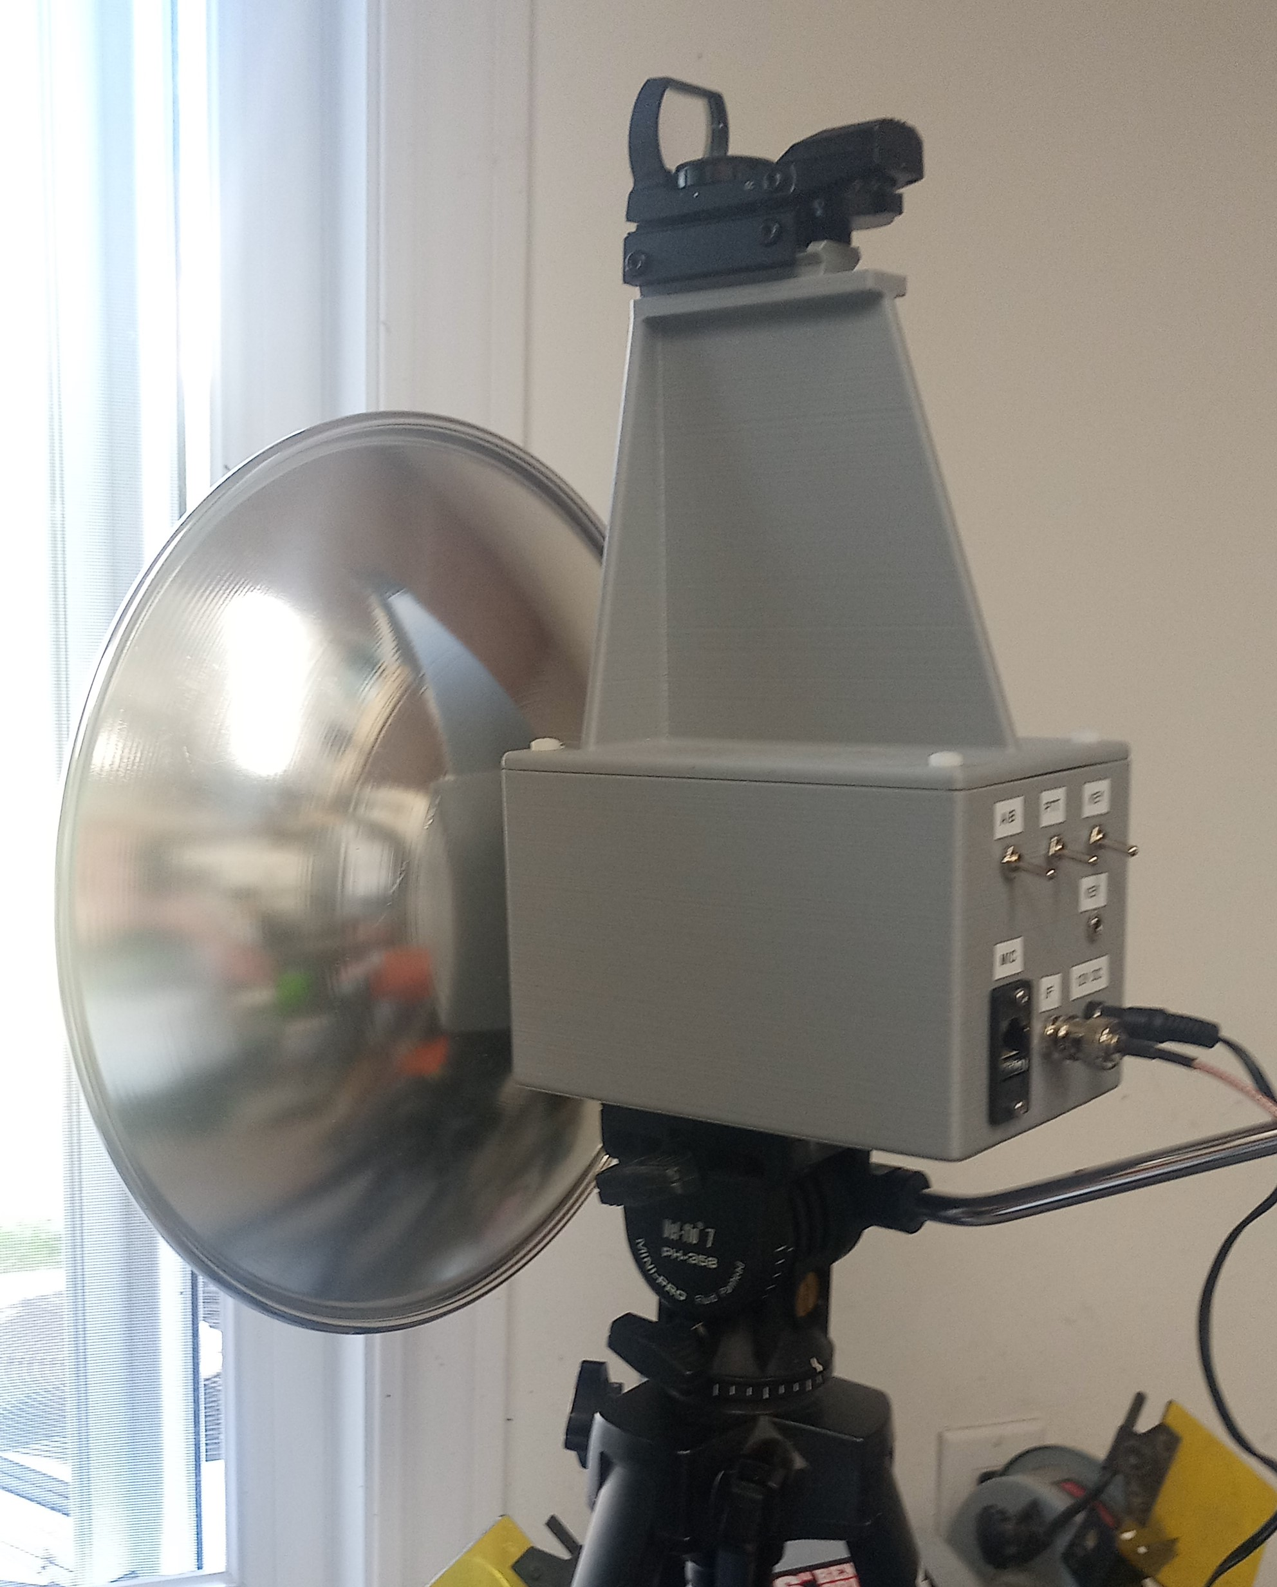
Wait, 122 GHz?
Yes, it can be done!
Subreflector.
Box.
PCB tray.
Scope mount.

Slide 27
122 GHz Gain and Efficiency
Bare feed = 14.9 dBi.
With CNC subreflector = 45.3 dBi.
With plastic subreflector = 45.1 dBi.
Efficiency = 24%

Slide 28
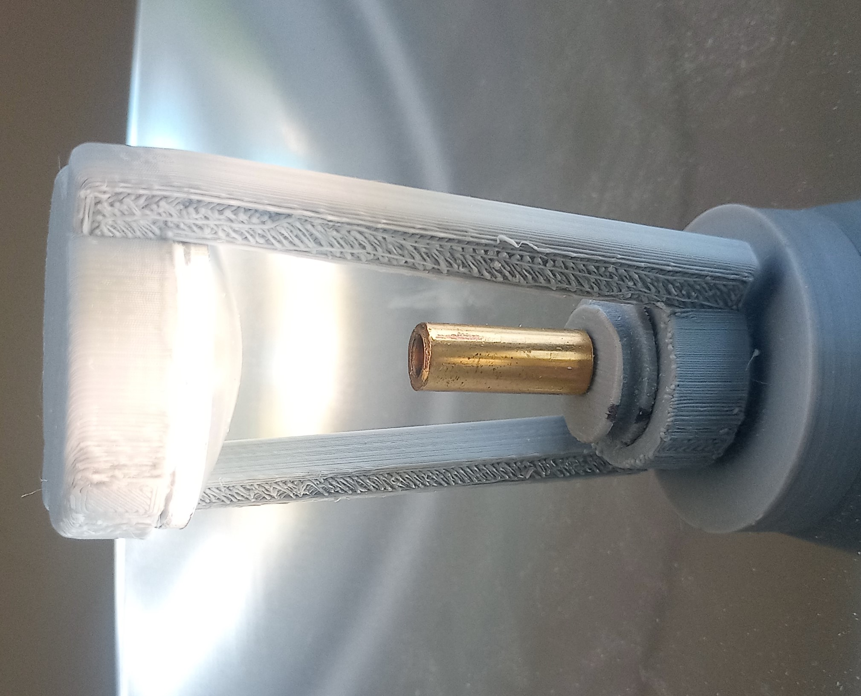
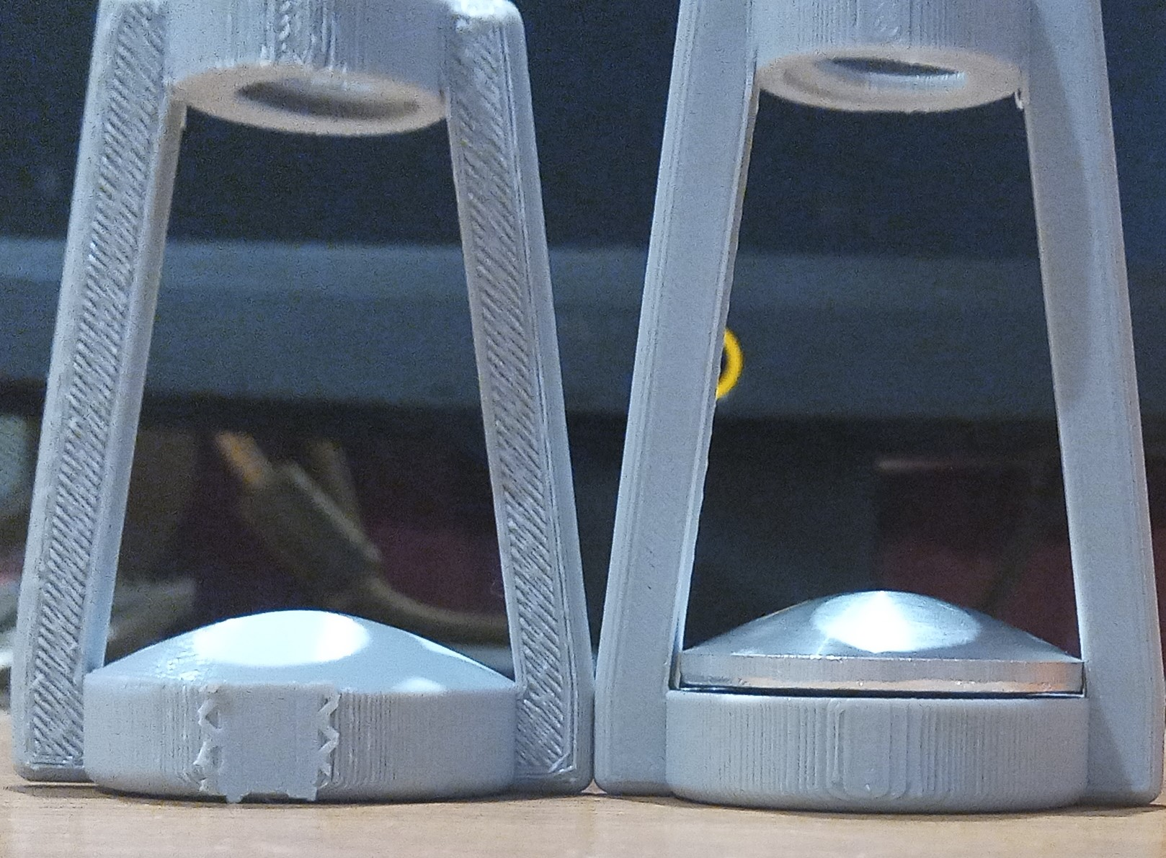
Plastic and CNC

Slide 29
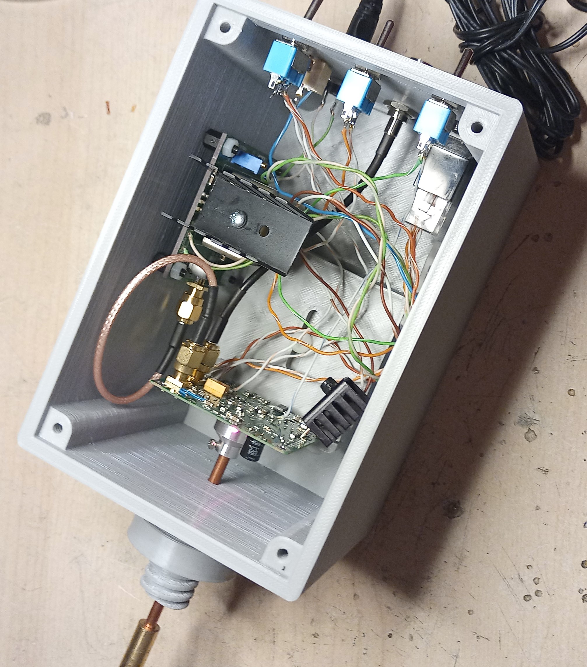
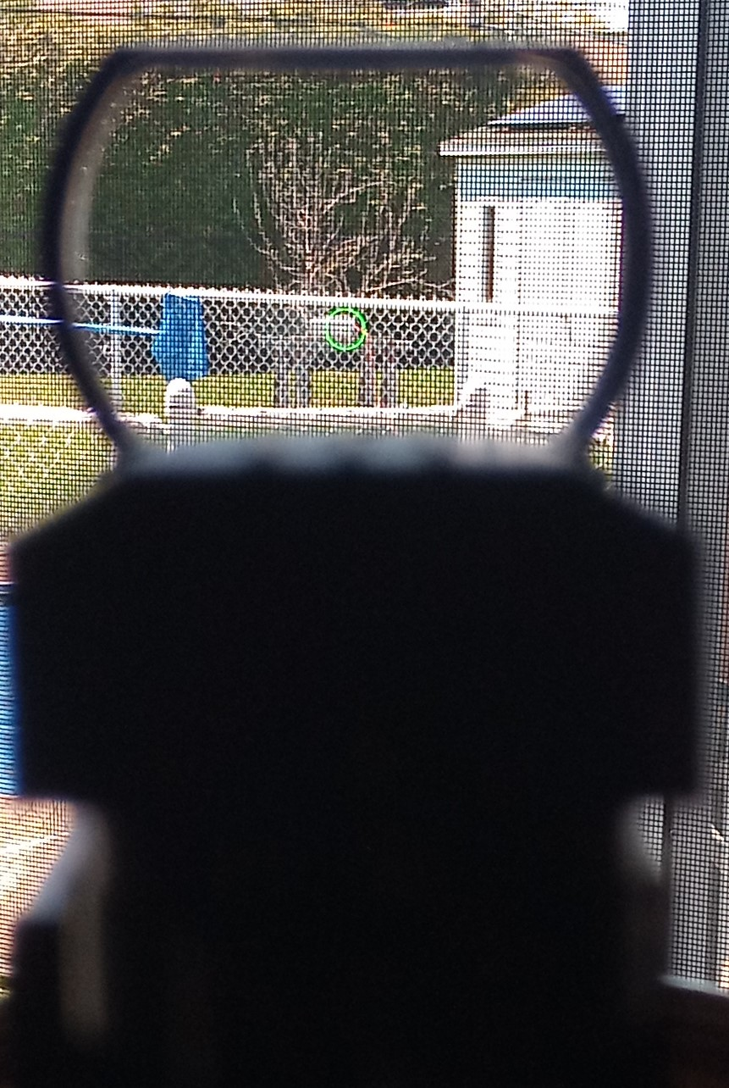
Box and Scope Mount

Slide 30
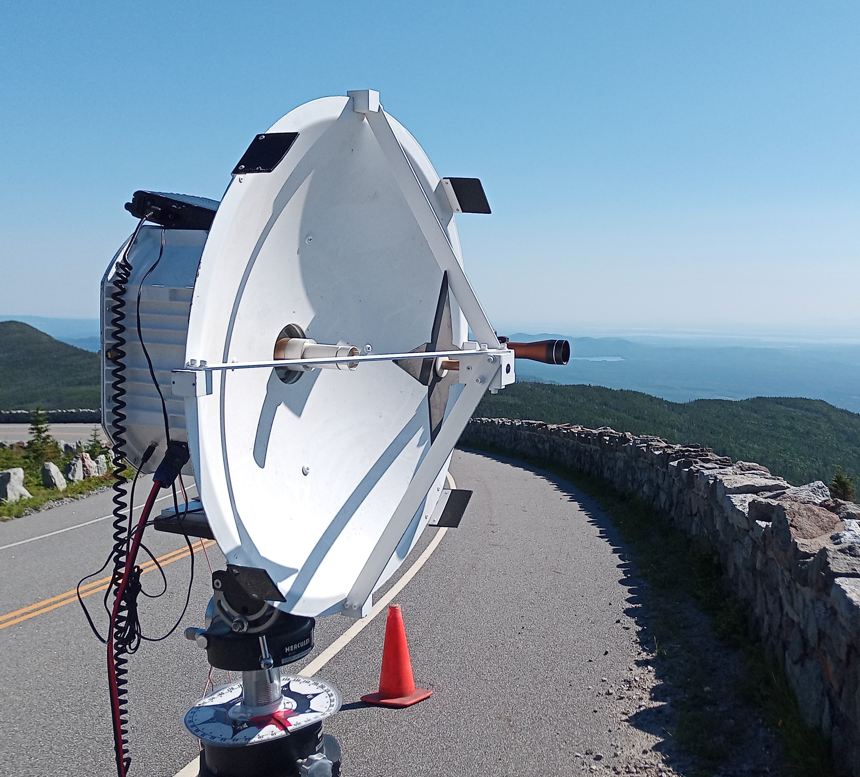
And 78 GHz?
No design yet.
But have Loea commercial antenna as baseline.
71-76 / 81-86 GHz.
Gain is 49.9/51.2 dBi.
Efficiency 46-48%
The design at 47 GHz compare well to it.

Slide 31
Special Thanks
Thanks to Paul Wade W1GHZ, who took the time and effort to design the feeds and subreflectors.
To my wife, who was wondering why I stayed hours in the cold ☺

